Slide 1
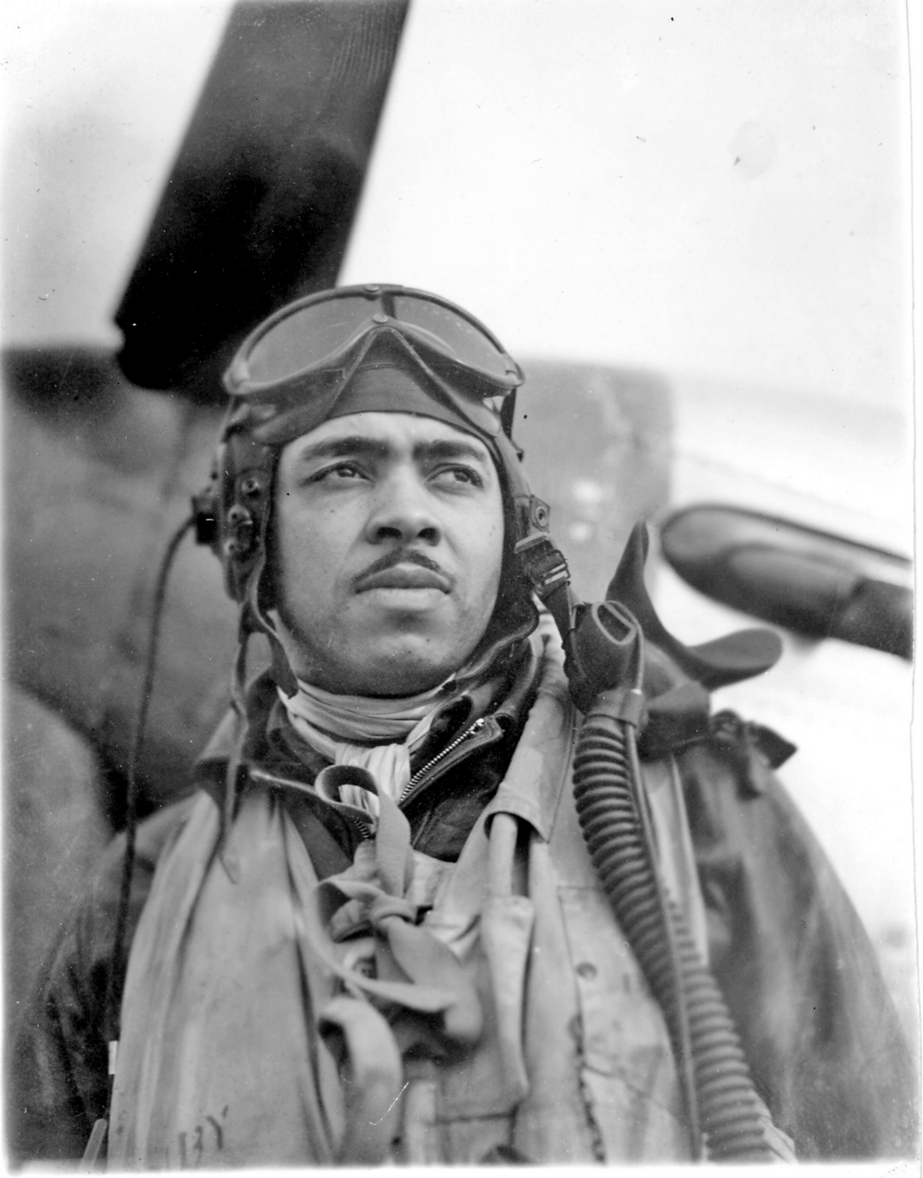

DIGITAL MAC PACK: LT. COLONEL JACK D. HOLSCLAW
PHOTO CREDIT: FAMILY PHOTO VIA TORNADO CREEK PUBLICATIONS
INTRODUCTION
BEFORE 1940, AFRICAN AMERICANS WERE BARRED FROM FLYING FOR THE U.S. MILITARY. DUE TO THE PRESSURE APPLIED BY CIVIL RIGHTS ORGANIZATIONS AND THE BLACK PRESS, THE FIRST ALL AFRICAN AMERICAN PURSUIT SQUADRON WAS FORMED IN 1941. IT WAS BASED IN TUSKEGEE, ALABAMA. THEY BECAME KNOWN AS THE TUSKEGEE AIRMEN. THIS IS THE STORY OF ONE OF THOSE AIRMEN WHO GREW UP IN SPOKANE, WASHINGTON. HIS NAME WAS JACK D. HOLSCLAW.
  Pursuit Squadron

Slide 2
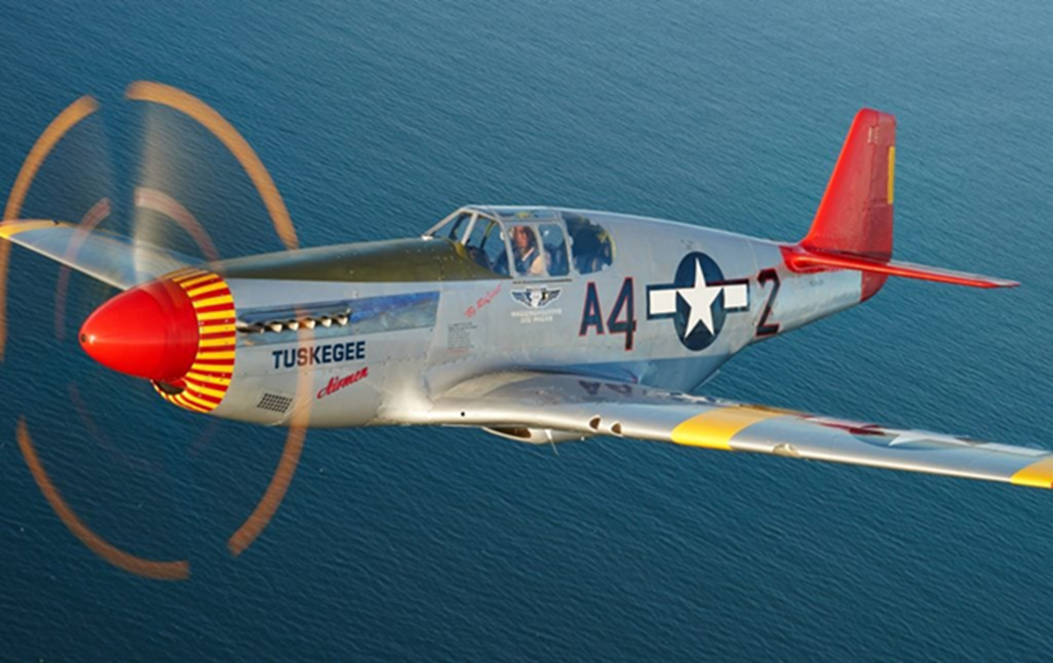
DIGITAL MAC PACK: LT. COLONEL JACK D. HOLSCLAW
PHOTO CREDIT: ARIZONA COMMEMORATIVE AIR BASE
TUSKEGEE AIRMEN
OVERCOMING PREJUDICE AND SEGREGATION, THE TUSKEGEE AIRMEN WOULD BECOME ONE OF THE MOST HIGHLY RESPECTED FIGHTER GROUPS OF WWII. THEY PROVED TO THE WORLD THAT AFRICAN AMERICANS COULD FLY AND MAINTAIN SOPHISTICATED COMBAT AIRCRAFT. THEIR ACHIVEMENTS WOULD LEAD THE WAY TO FULL RACIAL INTEGRATION OF THE U.S. MILITARY.
  Pursuit Squadron

Slide 3
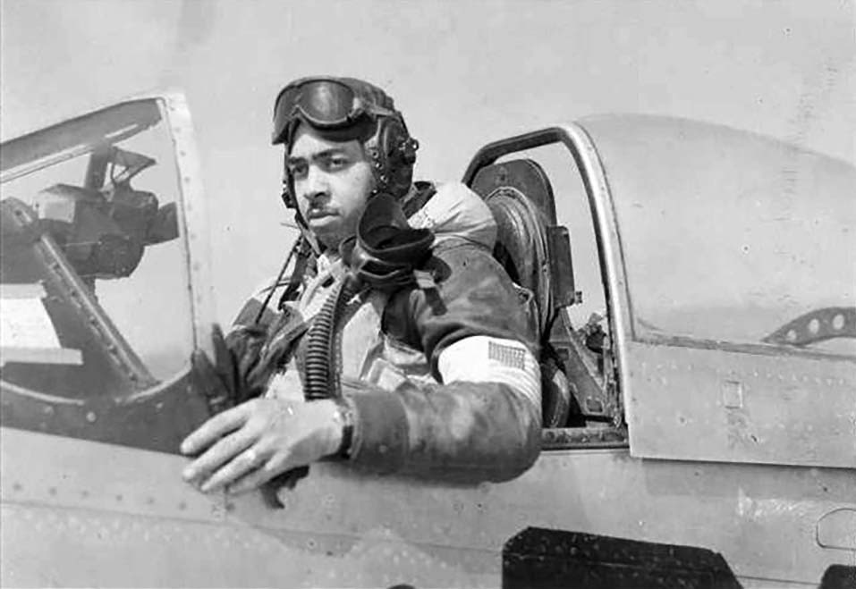
DIGITAL MAC PACK: LT. COLONEL JACK D. HOLSCLAW
PHOTO CREDIT: FAMILY PHOTO VIA TORNADO CREEK PUBLICATIONS
WHO WAS JACK HOLSCLAW?
JACK HOLSCLAW GREW UP IN SPOKANE WASHINGTON. HE WAS A WWII FIGHTER PILOT IN THE 100TH SQUADRON OF THE 332ND AIR GROUP STATIONED IN ITALY. THIS SQUADRON IS ALSO KNOWN AS THE TUSKEGEE AIRMEN.
AS YOU READ THROUGH THESE PAGES, LEARN ABOUT THE TUSKEGEE AIRMEN AND THEIR LEGACY. ANALYZE HISTORIC PHOTOS, OBJECTS, AND NEWSPAPER ARICLES. ADD TO YOUR KNOWLEDGE ABOUT WHERE ELSE YOU CAN RESEARCH THE TOPIC.
  Escort Fighters

Slide 4
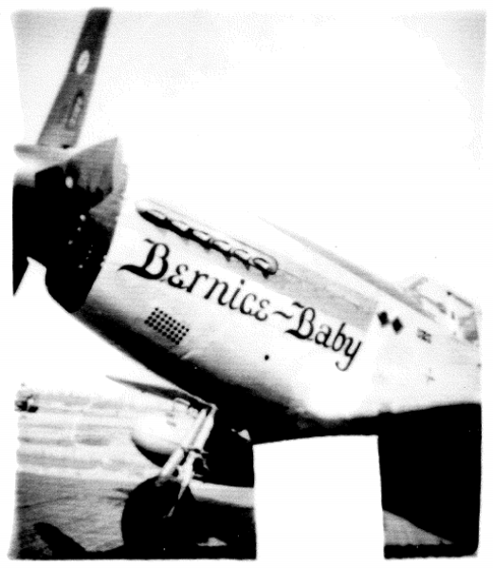
DIGITAL MAC PACK: LT. COLONEL JACK D. HOLSCLAW
PHOTO CREDIT: FAMILY PHOTO VIA TORNADO CREEK PUBLICATIONS AND JAMES QUANN INTERVIEW TRANSCRIPT AT WSU
EDUCATION
JACK HOLSCLAW WAS BORN MARCH 21ST, 1918 IN THE WEST CENTRAL NEIGHBORHOOD OF SPOKANE, WA TO CHARLES AND NELL HOLSCLAW. HIS FATHER WAS A CLERK WHO WORKED IN THE CRESCENT DEPARTMENT STORE, AND HIS MOTHER WAS A TEACHER. HE GRADUATED FROM NORTH CENTRAL HIGH SCHOOL IN 1935 AND WAS THE FIRST AFRICAN AMERICAN TO ACHIEVE THE RANK OF EAGLE SCOUT IN SPOKANE.
AFTER HIS GRADUATION, HE ATTENDED WHITWORTH UNIVERSITY WHERE HE MET HIS WIFE, BERNICE WILLIAMS. HE THEN ATTENDED WASHINGTON STATE COLLEGE WHERE HE PLAYED BASEBALL. FINALLY, GRADUATING FROM WESTERN STATE COLLEGE IN PORTLAND, OREGON IN 1942 WITH A DEGREE IN NATUROPATHY. HE INTENDED TO BECOME A CHIROPRACTOR. HOWEVER, ATTENDANCE AT THE CIVILIAN PILOT TRAINING PROGRAM DURING WWII CHANGED HIS PLANS, LEADING HIM TO A CAREER IN THE AIRFORCE.
  North Central High School

Slide 5
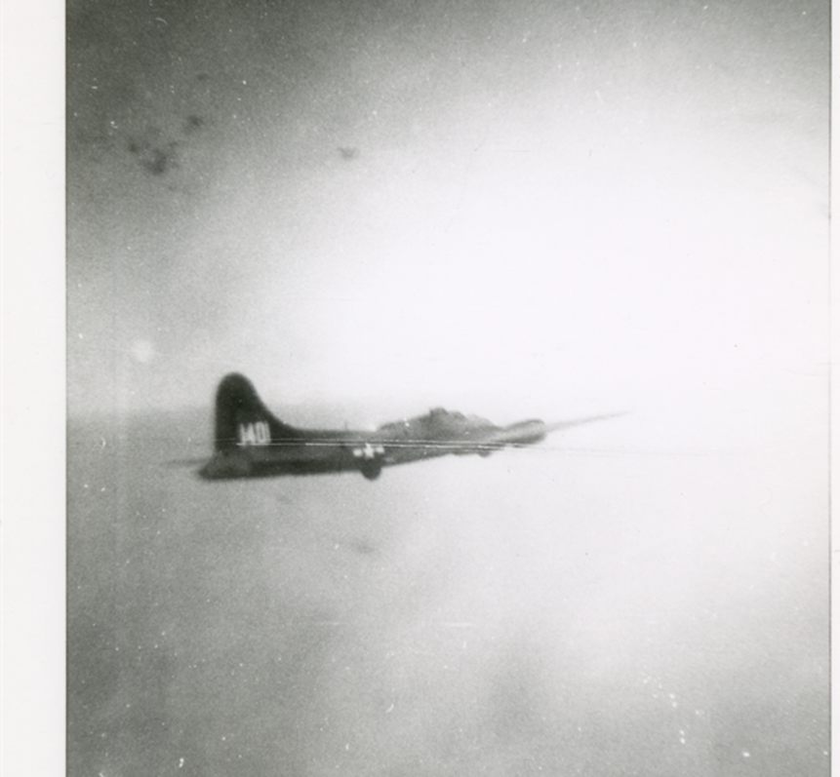
DIGITAL MAC PACK: LT. COLONEL JACK D. HOLSCLAW
MAC 431.24.N: THIS PHOTO WAS TAKEN FROM A B-24 DURING A BOMBING MISSION OVER EUROPE ORIGINATING OUT OF ITALY. FROM THE WES CROW COLLECTION.
332ND AIR GROUP: THE TUSKEGEE AIRMEN
IN FEBRUARY OF 1942 JACK HOLSCLAW TOOK THE AVIATION CADET QUALIFYING EXAMINATION. IN DECEMBER OF THAT YEAR, HE RECEIVED HIS ORDERS TO REPORT TO TUSKEGEE COLLEGE, LOCATED IN ALABAMA, TO ATTEND FLIGHT SCHOOL.
THE TUSKEGEE INSTITUTE WAS ONE OF 1,132 COLLEGES AND 1,460 FLIGHT SCHOOLS ACROSS THE NATION THAT PARTICIPATED IN THE CIVILIAN PILOT TRAINING PROGRAM. TUSKEGEE HAD BEEN AWARDED THE CONTRACT AS THE PRIMARY FACILITY FOR TRAINING AFRICAN AMERICAN AIRMEN.
  332nd Air Group

Slide 6
DIGITAL MAC PACK: LT. COLONEL JACK D. HOLSCLAW
PHOTO OF LT. COL. HOLSCALW’S P-51 MUSTANG THAT HE FLEW OVER EUROPE DURING WWII. HE NAMED HIS PLANE AFTER HIS WIFE, BERNICE
THE HOME FRONT
HOLSCLAW COMPLETED FLIGHT SCHOOL AND RECEIVED HIS COMMISSION AS A SECOND LIEUTENANT IN THE ARMY AIR FORCE ON JULY 28TH, 1943. FOLLOWING HIS TRAINING, HE RETURNED TO PORTLAND AND MARRIED BERNICE WILLIAMS ON AUGUST 24TH, 1943.
BERNICE WAS A VOCALIST, PIANIST, AND ORGANIST. THOUGH SHE NEVER OBTAINED A DEGREE IN MUSIC, HOLSCLAW DECLARED THAT “SHE CAN PROBABLY DO MORE WITH MUSIC THAN THOSE WITH DEGREES”.
SUPPORT AND LETTERS FROM HOME WERE CRUCIAL IN MAINTAINING MORALE OF THE AIRMEN ON THE FRONTLINES AND LIFE ON THE HOME FRONT WAS A SIGNIFICANT PART OF THE WAR EFFORT. THE UNITED STATES GOVERNMENT IMPOSED AND DIRECTED RATIONING AND MANPOWER ALLOCATION FOR CITIZENS AND BUSINESSES. WOMEN LIKE BERNICE WERE MOBILIZED TO AN UNPRECEDENTED DEGREE TO WORK IN JOBS THAT WERE NEEDED FOR THE WAR EFFORT.
  Bernice Baby

Slide 7
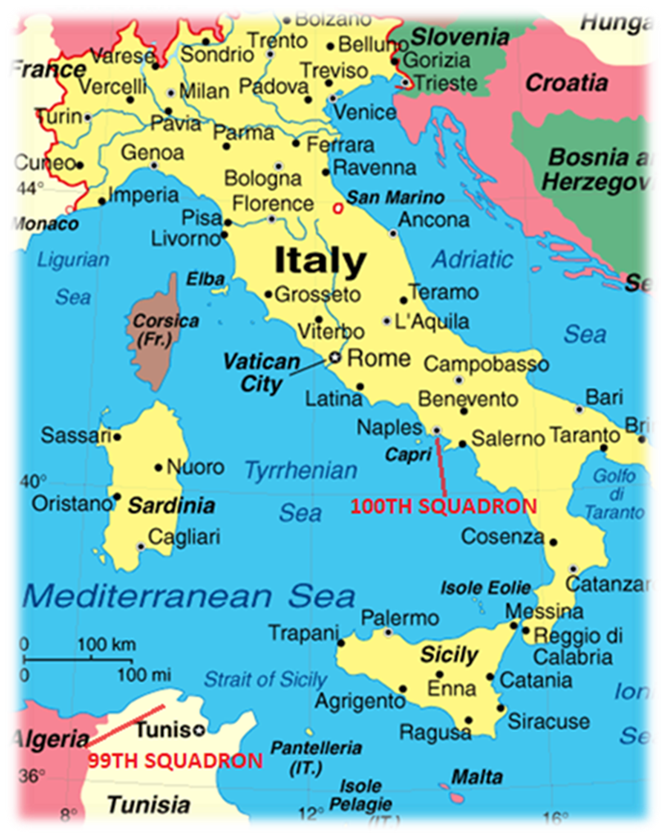
DIGITAL MAC PACK: LT. COLONEL JACK D. HOLSCLAW
“ORIGINS OF THE TUSKEGEE AIRMEN- THE 99TH FIGHTER SQUADRON’S FIRST ENCOUNTER WITH ENEMY AIRCRAFT” AMERICAN BATTLE MONUMENTS COMMISION 2018
SERVICE IN ITALY
ON DECEMBER 30TH, 1943, HOLSCLAW AND HIS SQUADRON BOARDED THE LIBERTY SHIP FROM NORFOLK VIRGINIA AND LANDED IN NAPLES ITALY. ONCE THERE, HIS SQUAD HAD CONVOY DUTY FLYING THE P-39 AIRCRAFT FOR ROUGHLY FOUR TO FIVE MONTHS. THEY WERE THEN ATTACHED TO THE 15TH AIR FORCE, WHERE THEY SHIFTED THEIR DUTY TO ESCORT FIGHTERS FLYING P-51 MUSTANGS. THIS IS WHERE HE AND HIS GROUP SHOWED THEIR COURAGE AND SKILL IN COMBAT.
THE 100TH SQUADRON ESCORT FIGHTERS PROTECTED THE B-17 AND B-24 BOMBERS, KEEPING THEM SAFE DURING BOMBING MISSIONS. MISSIONS TOOK FOUR TO FIVE HOURS TO COMPLETE.
  Escort for B-17 and B-24 Bombers

Slide 8
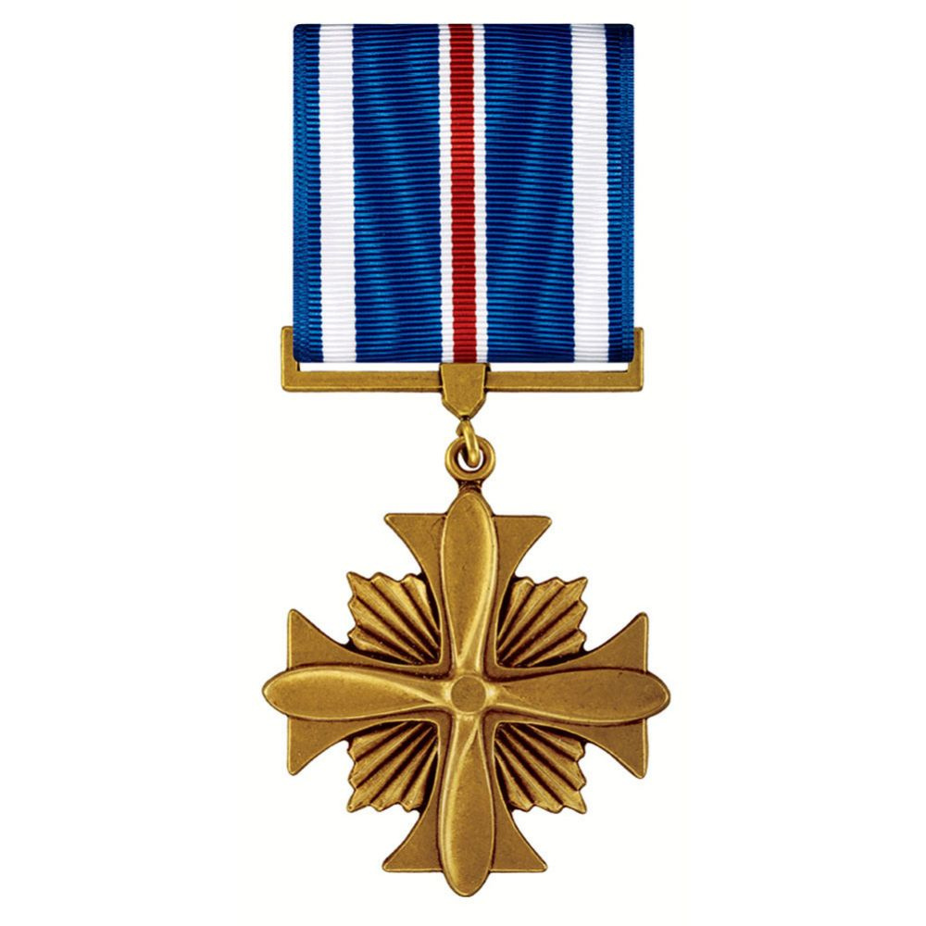
DIGITAL MAC PACK: LT. COLONEL JACK D. HOLSCLAW
PHOTO CREDIT: HTTPS: VALOR.DEFENSE.GOV/DESCRIPTION-OF-AWARDS
DISTINCT AND UNCOMMON SERVICE
HOLSCLAW PARTICIPATED IN SEVEN MAJOR CAMPAIGNS AS AN ESCORT FIGHTER PILOT. ONE OF THE MISSIONS EARNED HIM THE DISTINGUISHED FLYING CROSS WHICH IS ONE OF HIGHEST HONORS IN THE ARMY AIR CORP. DURING THIS MISSION, 64 AIRCRAFT FLYING IN BAD WEATHER, ESCORTED HEAVY BOMBERS ON THE WAY TO DESTROY TARGETS NEAR MUNICH, GERMANY. THIS WAS A TRIP OF OVER 900 NAUTICAL MILES WHICH EQUALS 1035.7 LAND MILES. THE GROUP LEADER WAS FORCED TO HEAD BACK TO BASE DUE TO ENGINE TROUBLE. HOLSCLAW, WITHOUT BEING ORDERED, TOOK OVER THE COMMAND. IN THIS CAMPAIGN, HOLSCLAW’S SQUAD WOULD ENCOUNTER A FORCE OF ROUGHLY 300 GERMAN ENEMY AIRCRAFT. DURING THE BATTLE, HOLSCLAW AND HIS FELLOW PILOTS DOWNED ELEVEN AIRCRAFT WITH HOLSCLAW DOWNING TWO MESSERSCHMITT 109 AIRCRAFT. HE EARNED THE DISTINGUISHED FLYING CROSS ON SEPTEMBER 6TH, 1944, FOR TAKING THE LEAD WHEN NOT NECESSARY AND SECURING A SUCCESSFUL MISSION.
THE DISTINGUISHED FLYING CROSS IS AWARDED TO PILOTS OF THE UNITED STATES MILITARY FOR EXTRAORDINARY SERVICE BEYOND THE GENERAL EXPECTATION AND SPECIFICALLY DISTINCT AND UNCOMMON SERVICE, WHILE ENGAGED WITH THE ENEMY.
  Awarded the Distinguished Flying Cross in 1944

Slide 9
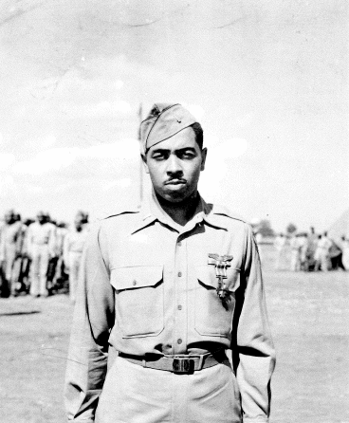
DIGITAL MAC PACK: LT. COLONEL JACK D. HOLSCLAW
PHOTO CREDIT: FAMILY PHOTO VIA TORNADO CREEK PUBLICATIONS AND JAMES QUANN WSU INTERVIEW
68 MISSIONS DURING WWII
DECEMBER 1944, HOLSCLAW BECAME THE ASSISTANT OPERATIONS OFFICER. AS SUCH, HE PLANNED MISSIONS FOR THE DURATION OF THE WAR IN EUROPE.
ON AVERAGE, AIRMEN FLEW 25 TO 50 MISSIONS. THE END OF THE WAR SAW AIRMEN FLYING CLOSER TO 50 MISSIONS. HOLSCLAW’S GROUP FLEW AN ASTOUNDING 70 MISSIONS. BY THE END OF THE WAR, THEY LACKED REPLACEMENTS. AS A RESULT, AIRMEN WERE FLYING MANY MORE MISSIONS. DUE TO COMBAT FATIGUE, PILOTS WERE OFTEN KILLED IN THEIR LAST FIVE MISSIONS. HOLSCLAW HAD COMPLETED OVER 30 MISSIONS BEFORE HIS APPOINTMENT AS ASSISTANT OPERATIONS OFFICER. HE HAD FLOWN 68 MISSIONS WHEN HE WAS FINALLY GROUNDED BY COLONEL BENJAMIN DAVIS JR WHO STATED HE HAD ALREADY PUT IN ENOUGH TIME AND HE WOULD NOT PROCEED WITH HIS 69TH. HE HAD MADE A POINT TO KEEP FLYING TO REMAIN SHARP IN HIS SKILLS, EVEN COMPLETING 18 MISSIONS IN 20 DAYS TOWARDS THE END OF HIS TOUR.
  Increased Missions at the End of the War

Slide 10
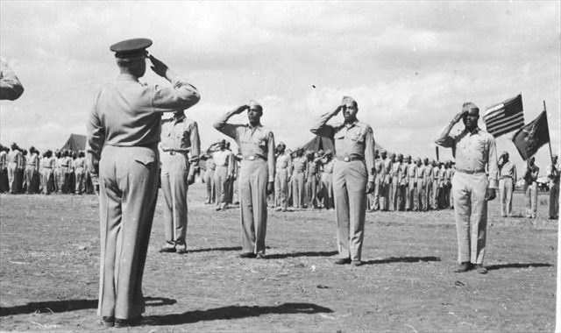
DIGITAL MAC PACK: LT. COLONEL JACK D. HOLSCLAW
PHOTO CREDIT: FAMILY PHOTO VIA TORNADO CREEK PUBLICATIONS AND JAMES QUANN WSU INTERVIEW
THE END OF FIGHTING IN EUROPE
TOWARDS THE END OF WWII, HOLSCLAW WAS SENT TO FOSTER FIELD, TEXAS FOR SIX WEEKS OF TRAINING TO BECOME A FIGHTER-GUNNERY INSTRUCTOR. THE WAR IN EUROPE ENDED WHILE HE WAS IN TEXAS AND HIS GROUP RETURNED FROM ITALY.
BY THE END OF THE WAR, HOLSCLAW PARTICIPATED IN SEVEN MAJOR CAMPAIGNS OVER SOUTHERN FRANCE, PO VALLEY, NORTH APENNINES, ROME-ARNO, BALKANS, NORTHERN FRANCE AND, OF COURSE, HIS HARROWING EXPERIENCE OVER GERMANY. MOST OF HIS DUTIES WERE ESCORTING B-17 AND B-24 BOMBERS. HE ROSE TO THE RANK OF CAPTAIN. HE EARNED SEVERAL AWARDS AND CITATIONS IN ADDITION TO THE DISTINGUISHED FLYING CROSS.
  Fighter-Gunnery Instructor

Slide 11
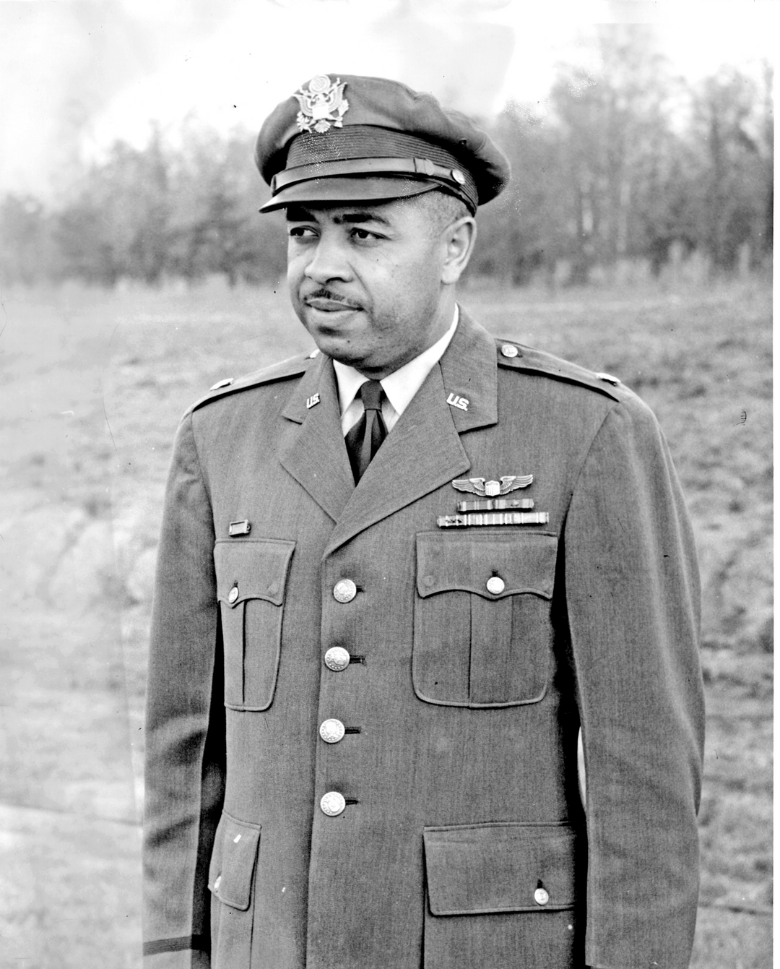
DIGITAL MAC PACK: LT. COLONEL JACK D. HOLSCLAW
PHOTO CREDIT: FAMILY PHOTO VIA TORNADO CREEK PUBLICATIONS AND JAMES QUANN WSU INTERVIEW
A CAREER IN THE MILITARY
AFTER WWII HOLSCLAW DECIDED TO MAKE THE AIR FORCE HIS CAREER. DURING THE KOREAN WAR HE WAS ASSIGNED AS OPERATIONS OFFICER FOR P-51 MUSTANG MISSIONS OVER KOREA. HE WAS ASSIGNED TO LEAD THE ROTC TRAINING IN THREE DIFFERENT UNIVERSITIES OVER FOUR YEARS INCLUDING TUSKEGEE COLLEGE. HE WAS THEN STATIONED IN JAPAN AND ASSIGNED TO FLYING DOUGLAS C-124 GLOBEMASTER PLANES OUT OF TOKYO. HE SERVED IN JAPAN UNTIL 1957. HE WAS STATIONED AT MITCHELL AIR FORCE BASE ON LONG ISLAND, NY AS AN OPERATIONS AND TRAINING OFFICER UNTIL 1961. HIS LAST STATION WAS HAMILTON AIR FORCE BASE OUTSIDE OF SAN FRANCISCO FLYING CARGO OUT OF VIETNAM ON A C-46. HOLSCLAW REACHED THE RANK OF LIEUTENANT COLONEL ON MARCH 15, 1962.
HOLSCLAW RETIRED FROM THE US AIR FORCE IN 1965. CIVILIAN WORK AFTER HIS RETIREMENT INCLUDED EXECUTIVE DIRECTOR OF MARIN COUNTY HOUSING AUTHORITY. HE ALSO WORKED FOR 10 YEARS AT THE PEOPLE’S BANK IN WASHINGTON’S PUGET SOUND AREA. LT. COL. HOLSCLAW RETIRED TO TUCSON, AZ IN 1983. OVER THE NEXT 15 YEARS OF HIS LIFE, HE WOULD PARTICIPATE IN OR BE THE SUBJECT OF NUMEROUS PUBLICATIONS RELATED TO HIS EXPERIENCES SERVING AS A TUSKEGEE AIRMEN.
  A Distinguished Career

Slide 12
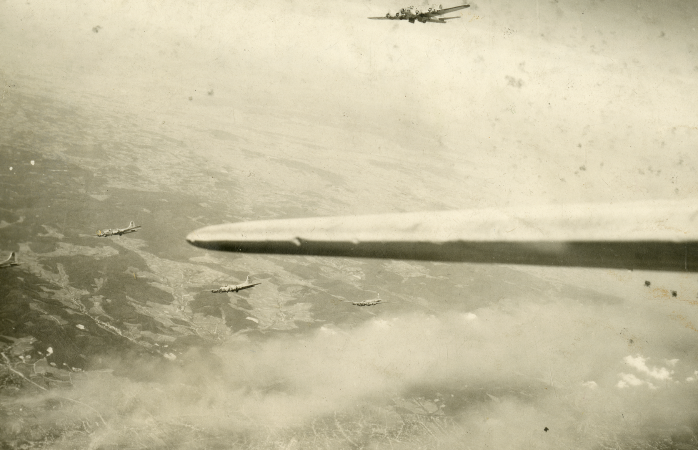
DIGITAL MAC PACK: LT. COLONEL JACK D. HOLSCLAW
PHOTO CREDIT: MAC 4310.24K. THIS IS A PHOTO FROM THE MAC’S WES CROW COLLECTION OF BOMBERS AND SUPPORT AIRCRAFT WHO ORIGINATED FROM ITALY FLYING ON BOMBING MISSIONS OVER EUROPE
LEGACY OF THE TUSKEGEE AIRMEN
JACK HOLSCLAW AND HIS FELLOW TUSKEGEE AIRMEN OVERCAME SEGREGATION AND PREJUDICE TO BECOME ONE OF THE MOST HIGHLY RESPECTED FIGHTER GROUPS OF WORLD WAR II. THEY PROVED CONCLUSIVELY THAT AFRICAN AMERICANS COULD FLY AND MAINTAIN SOPHISTICATED COMBAT AIRCRAFT. THEIR ACHIEVEMENTS PAVED THE WAY FOR DESEGREGATION OF THE MILITARY.
  Jack Holsclaw’s Legacy

Slide 13
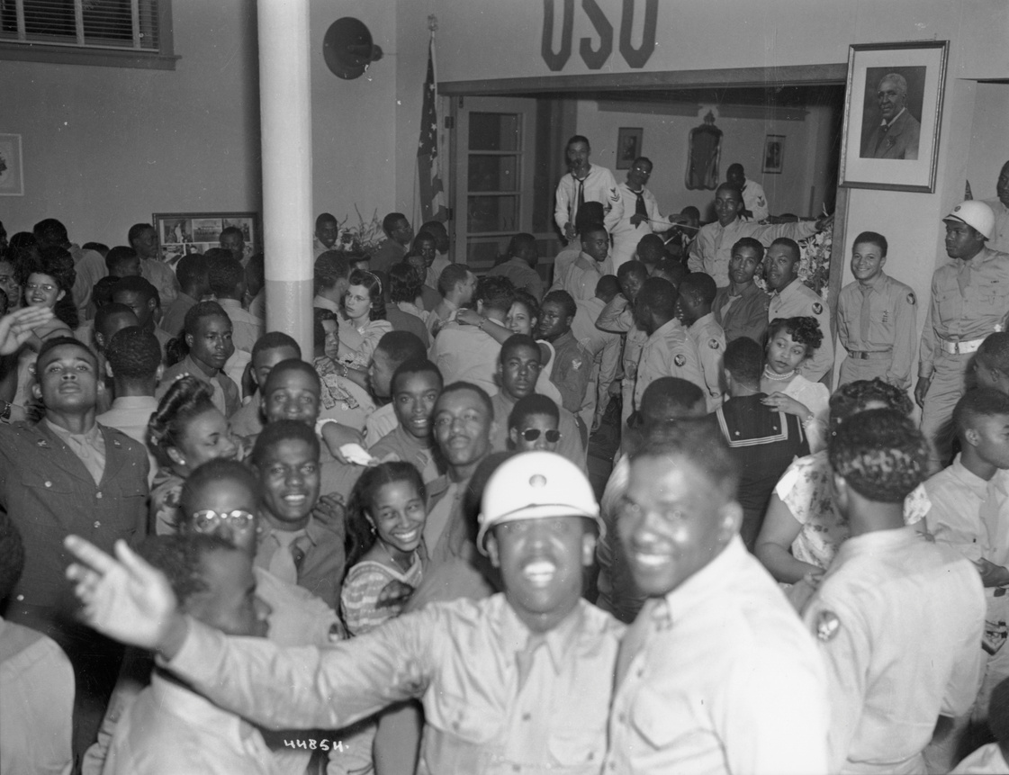
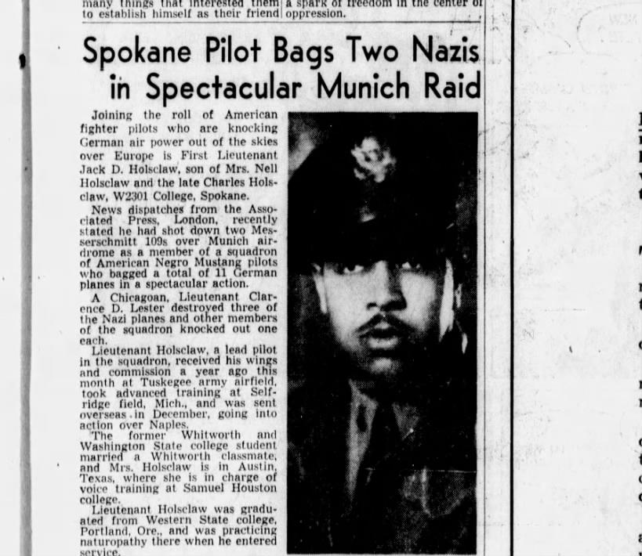
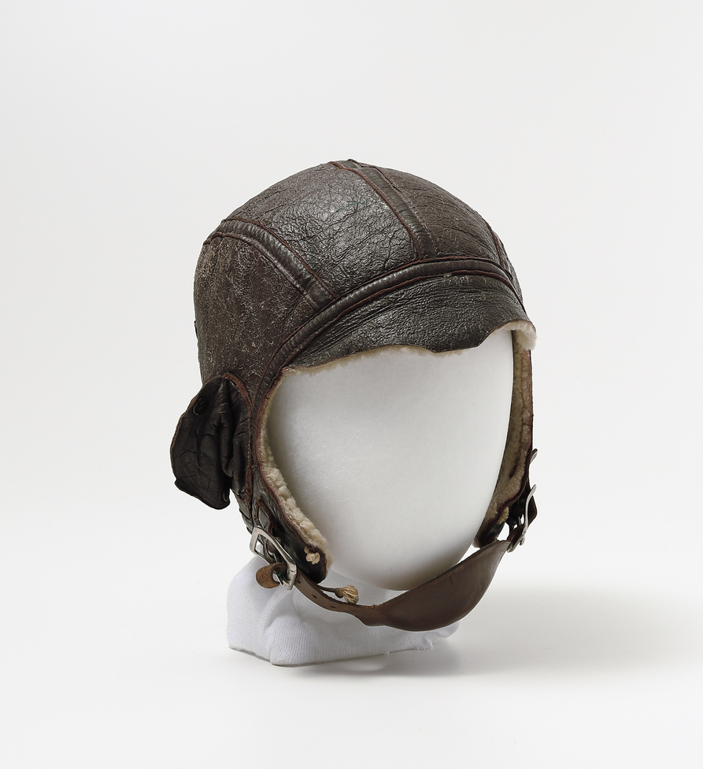
DIGITAL MAC PACK: LT. COLONEL JACK D. HOLSCLAW
JOEL E. FERRIS ARCHIVES L87-1.44854-45 GEORGE WASHINGTON CARVER USO SPOKANE 1945
NORMAN ERICKSON WWII MAC 4424.1
JACK HOLSCLAW SPOKESMAN REVIEW AUG 3 1944
WHERE TO LOOK FOR PRIMARY SOURCES
WANT TO LEARN MORE ABOUT SPOKANE HISTORY?
HERE ARE IDEAS TO FIND MORE INFORMATION:
  USE THE MAC’S WEBSITE TO RESEARCH ONLINE PHOTOS AND OBJECTS: HTTPS://WWW.NORTHWESTMUSEUM.ORG
  VISIT HISTORIC CAMPBELL HOUSE AT THE MAC
  CHECK OUT THE EXHIBITS AT THE MAC
  MAKE AN APPOINTMENT AT THE MAC TO SEARCH OUR ARCHIVES
  SEARCH THROUGH SPOKESMAN REVIEW AND SPOKANE CHRONICLE HISTORIC NEWSPAPERS
  VISIT WASHINGTON STATE ARCHIVES: HTTPS://WWW.SOS.WA.GOV/ARCHIVES/ARCHIVES_EASTERN.ASPX
  VISIT THE NORTHWEST ROOM AT THE SPOKANE PUBLIC LIBRARY: HTTPS://SPOKANELIBRARY.ORG/NORTHWEST-ROOM
  WASHINGTON STATE UNIVERSITY ARCHIVES: HTTPS://LIBRARIES.WSU.EDU/MASC/UNIVERSITY-ARCHIVES/
RESEARCH SPOKANE HISTORY

Slide 14
DIGITAL MAC PACK: ANALYZING NEWSPAPERS AND DOCUMENTS
ANALYZE THE NEWSPAPER ARTICLE TITLED: “SPOKANE PILOT BAGS TWO NAZIS IN SPECTACULAR MUNICH RAID”
Every piece of paper that people leave behind is full of clues. From diaries and letters to newspapers and census reports, documents tell us about the circumstances of everyday life and about significant events.
Tips for reading and analyzing documents and newspapers:
To be most useful, documents must be studied carefully and critically. (From Smithsonian resources: Engaging Students with Primary Sources)
What are your first impressions? What kind of document is it (letter, newspaper, etc.)? How do you know?
Look more closely: Read through the document carefully. Make a list of any unusual words or phrases.
Is there a date on it? If so, what is it? If not, are there any other clues that might indicate when it was written?
Is there a location indicated? What is it?
Who wrote or created the document? How can you tell?
For whom was the document written or created? How do you know?
What is the purpose of the document? What made you think this?
Thinking Further: What do you think the writer thought was the most important information to convey? Why?
Does the document convey a certain tone?
What does it imply without stating directly?
Can you tell the point of view of the writer? Is it objective?
What is the relationship between the writer and the audience? How can you tell?
  Civil Rights Lawsuit

Slide 15
DIGITAL MAC PACK: LT. COLONEL JACK D. HOLSCLAW
Spokesman Review August 3, 1944
  Spokesman Review Article

Slide 16
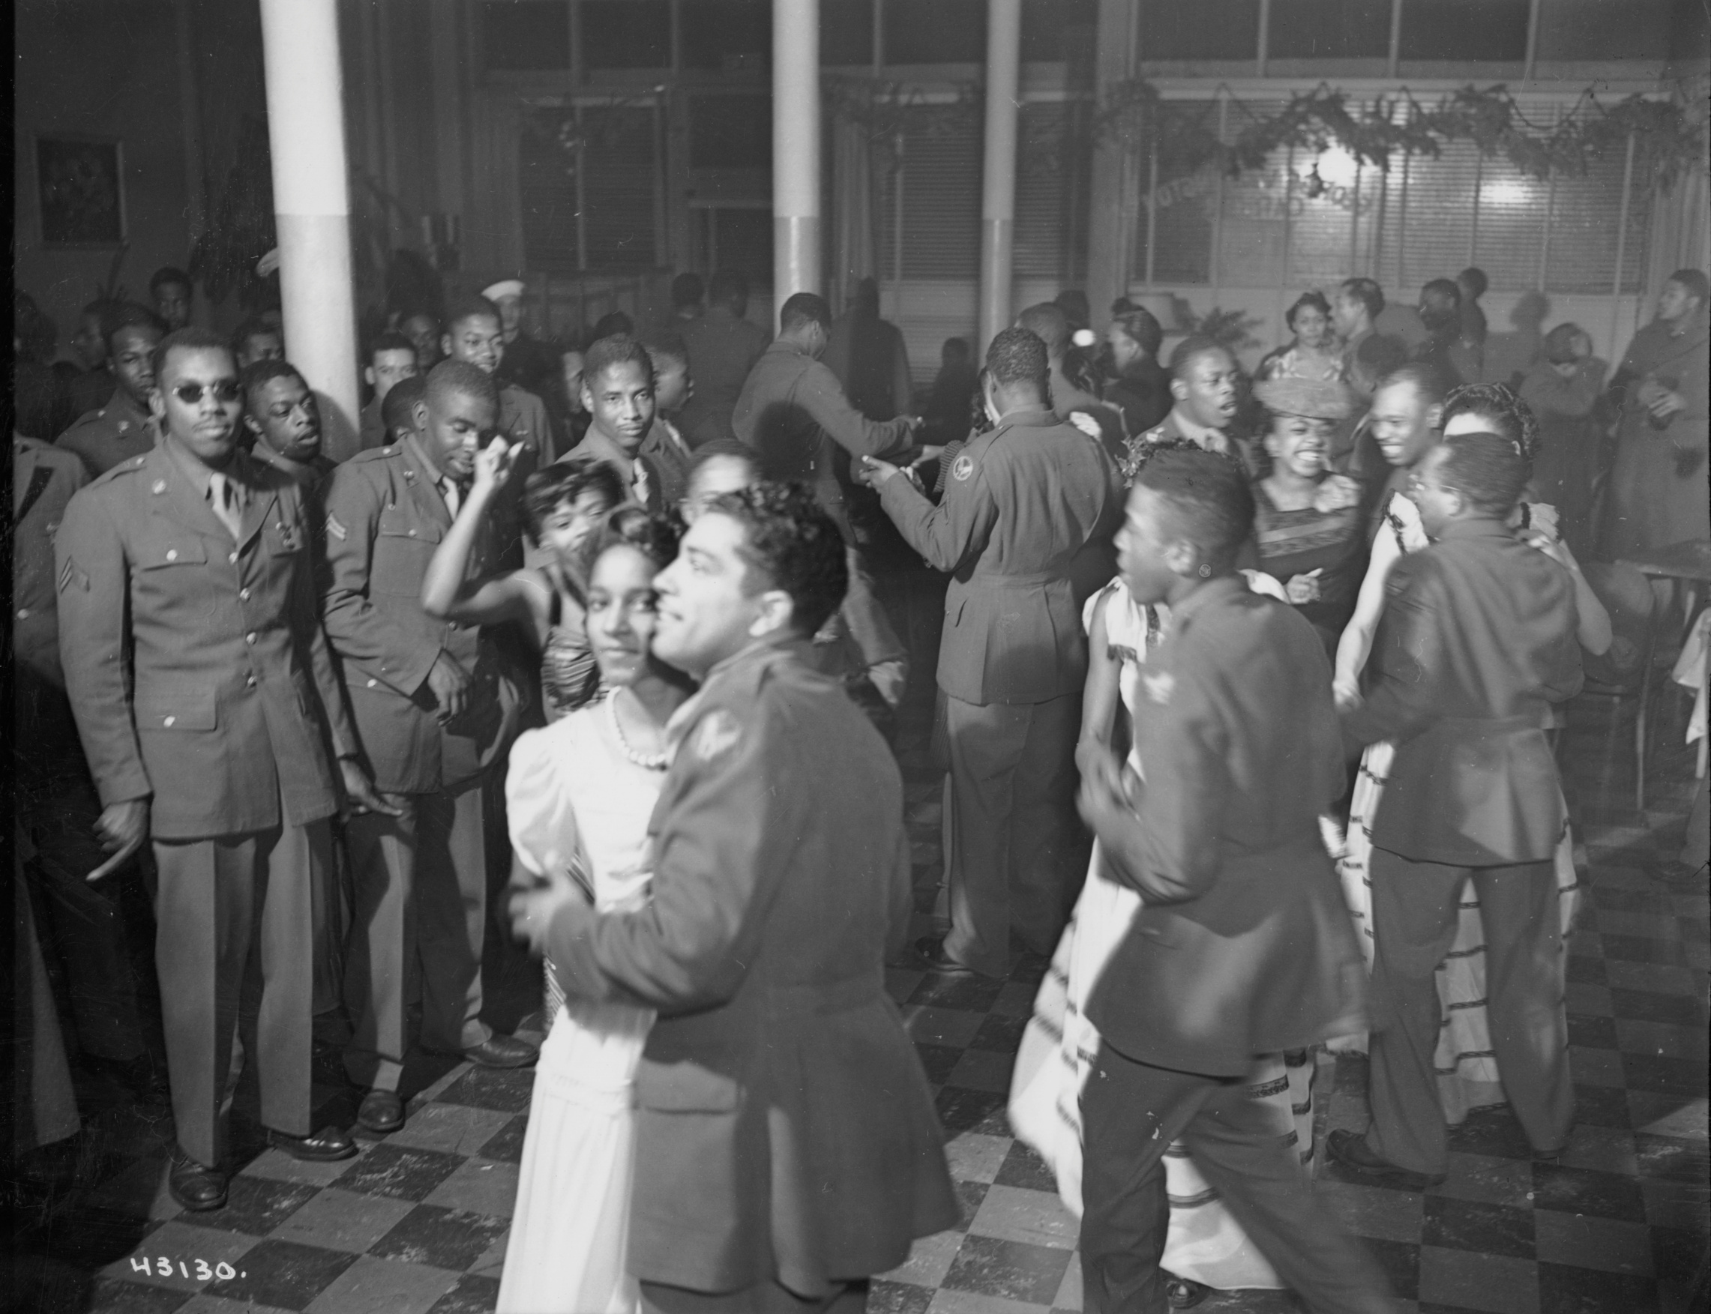
DIGITAL MAC PACK: ANALYZING PHOTOGRAPHS
TAKE A FEW MINUTES TO LOOK CLOSELY AT THIS PHOTOGRAPH
WHAT’S GOING ON WITH THIS PHOTOGRAPH?
WHAT DO YOU SEE THAT MAKES YOU THINK THAT?
WHAT MORE CAN YOU FIND?
SEE THE QUESTIONS ON THE NEXT PAGE TO HELP YOU ANALYZE THIS PHOTO AND THE OTHER PHOTOS IN THIS DIGITAL MAC PACK
Joel E. Ferris Research Archives L87-1.43130-45 George Washington Carver USO Dance Spokane 1945
  What’s going on in this photo?

Slide 17
DIGITAL MAC PACK: ANALYZING PHOTOS
Photographs provide us with images of past events. Today, historians study the content and the meaning of these visual images to locate information about a particular topic, time, or event. Photographs can convey countless details about life. For historians and for us, “A picture is worth a thousand words.” Photographers have the ability to manipulate, intentionally or unintentionally, the record of the event. It is the photographer—and the camera’s frame—that defines the picture’s content. Thus, the photographer chooses what will be in the picture, what will be left out, and what the emphasis will be.
(From Smithsonian resources: Engaging Students with Primary Sources)
Take a few minutes to look at the photos in this Digital MAC Pack. Use these questions to help you analyze what’s going on in this photo:
First Impressions: What are your first impressions?
Take a closer look: Make sure to examine the whole photograph. Make a list of any people in the photograph. What is happening in the photograph? Make a list of any activities you see going on in the photograph. Make a list of any objects in the photograph.
Looking more closely: Are there any captions? A date? Location? Names of people? What kind of clothing is being worn? Is there any lettering on signs or buildings? What time of year is pictured? Time of day? Cite your evidence. Where was the photograph taken? Cite your evidence.
Thinking Further: If people are in the photograph, what do you think is their relationship to one another? Can you speculate on a relationship of the people pictured and someone who is not in the picture?
Here are a few more tips for reading photographs: What do you think happened before and after the photo was taken? Who do you think took the photo and why?
What does this photograph suggest to you? What questions do you have about the photo? How could you try to answer them?
What is the one thing that you would remember most about this photograph and why?
What questions do you have about the photograph that you cannot answer through analyzing it? Where could you go next to answer these questions?

Slide 18
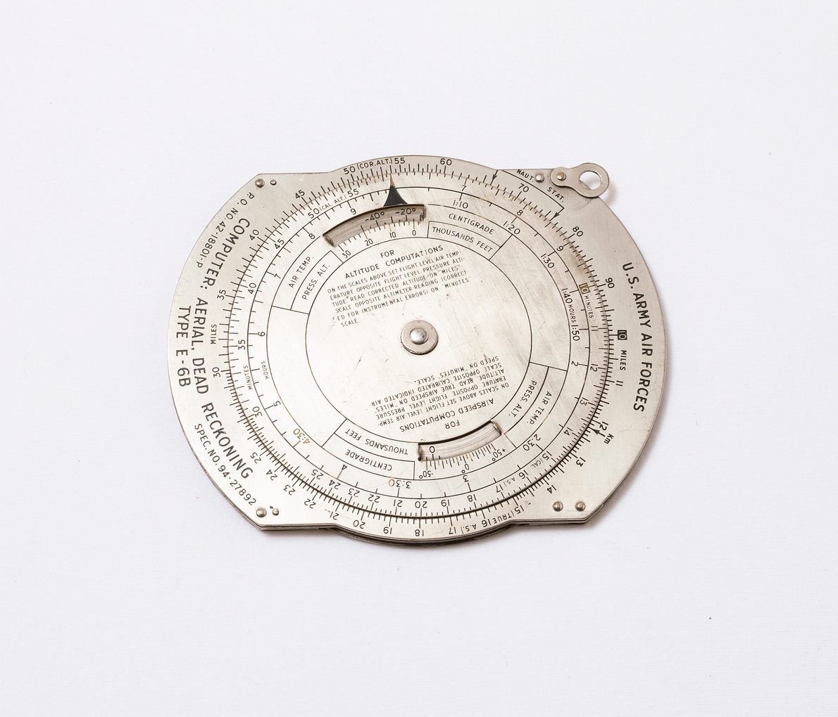
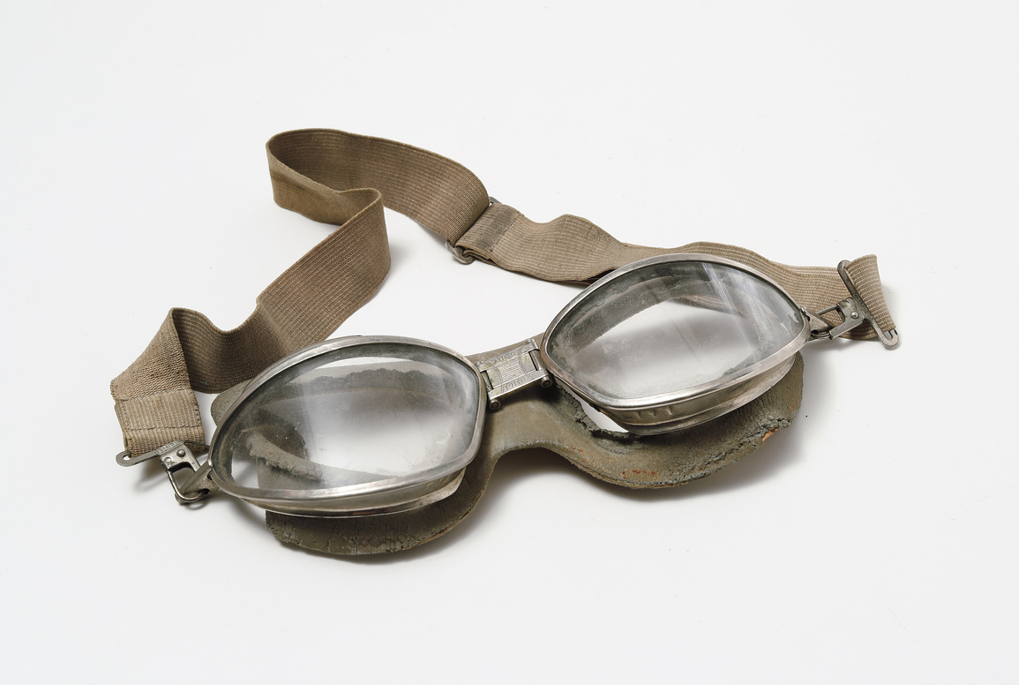
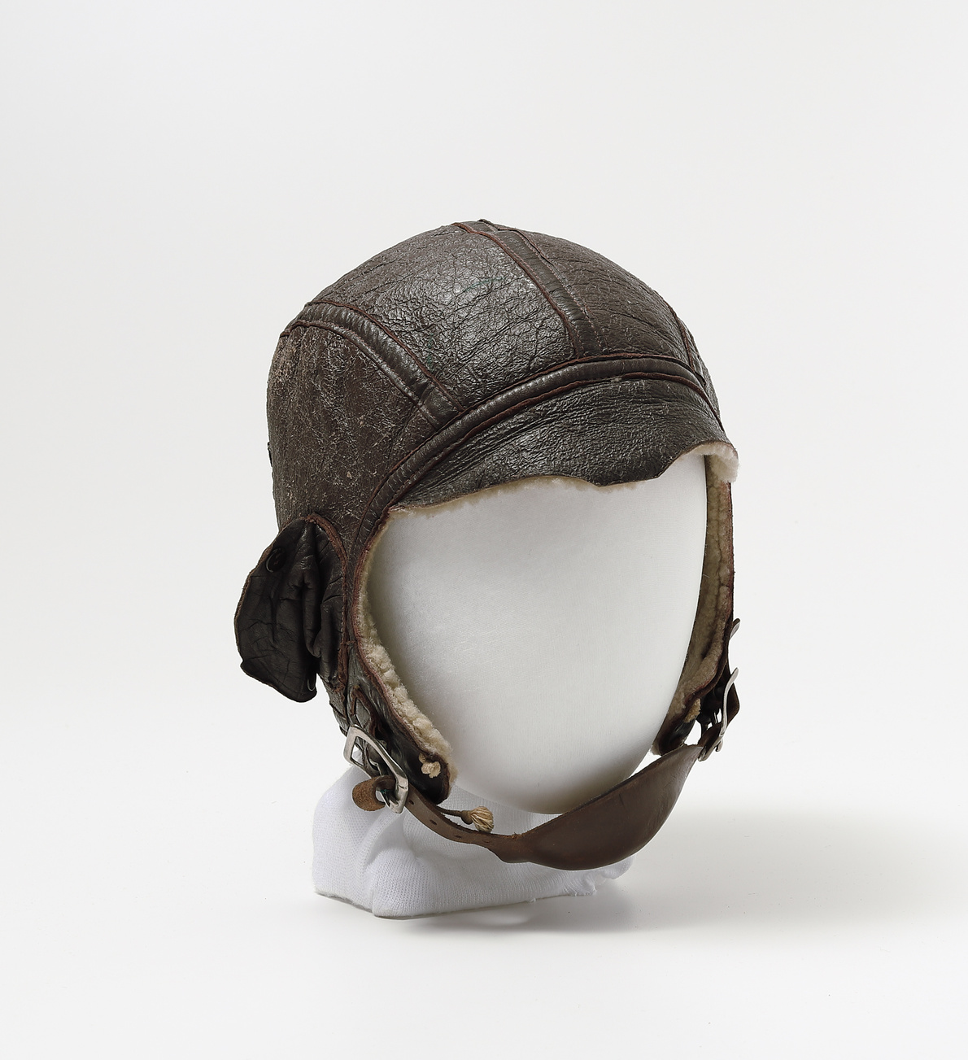
DIGITAL MAC PACK: ANALYZING OBJECTS
All Objects are from the Northwest Museum of Arts and Culture’s (MAC) Collections
MAC 4424.2 WWII NORMAN ERICKSON AVIATOR GOGGLES
MAC 4310.17 WWII E6B FLIGHT COMPUTER
MAC 4424 NORMAN ERICKSON WWII

Slide 19
DIGITAL MAC PACK: ANALYZING OBJECTS
Historians study objects, the material culture that people from the past left behind, in order to understand history. because objects are the products of human workmanship - of human thought and effort - objects tell something about the people who designed, made, and used them. (From Smithsonian resources: Engaging Students with Primary Sources)
First Impressions: What are your first impressions of this object? Do you have any ideas what the object might have been used for?
Look more closely: Physical Features: What is it made of? Why was this material chosen? What is the texture and color? What does it smell like? Can it be held? Is it heavy or light? Is it intact, or does it look like parts are missing? Is it clean or dirty? Does it make a noise? Does it look old or new?
Construction: Is it handmade or made by machine? Where was it made?
Who made it?
Function: How is this object used? Does it have a practical use or is (was) it used for pleasure? Has it been used? Is it still in use? Has the use changed? Where can it be found? Where could it have been found? What value does it hold to you and to others?
Design: Is it designed well? Is it decorated? How is it decorated? Is it aesthetically pleaseing? Would it make a good gift? Does it remind you of anything else?
Who may be connected with the object? What type of person might have used this object? What type of person might have made this object? What does this object tell us about the maker and user?
Thinking Further: Is this type of object still being made today? Is it still in use? If not, why do you think it isn’t used today?
Should this object be in a museum collection? Why or why not?
What questions do you have about the object that you can’t answer from just looking at it?

