Slide 1
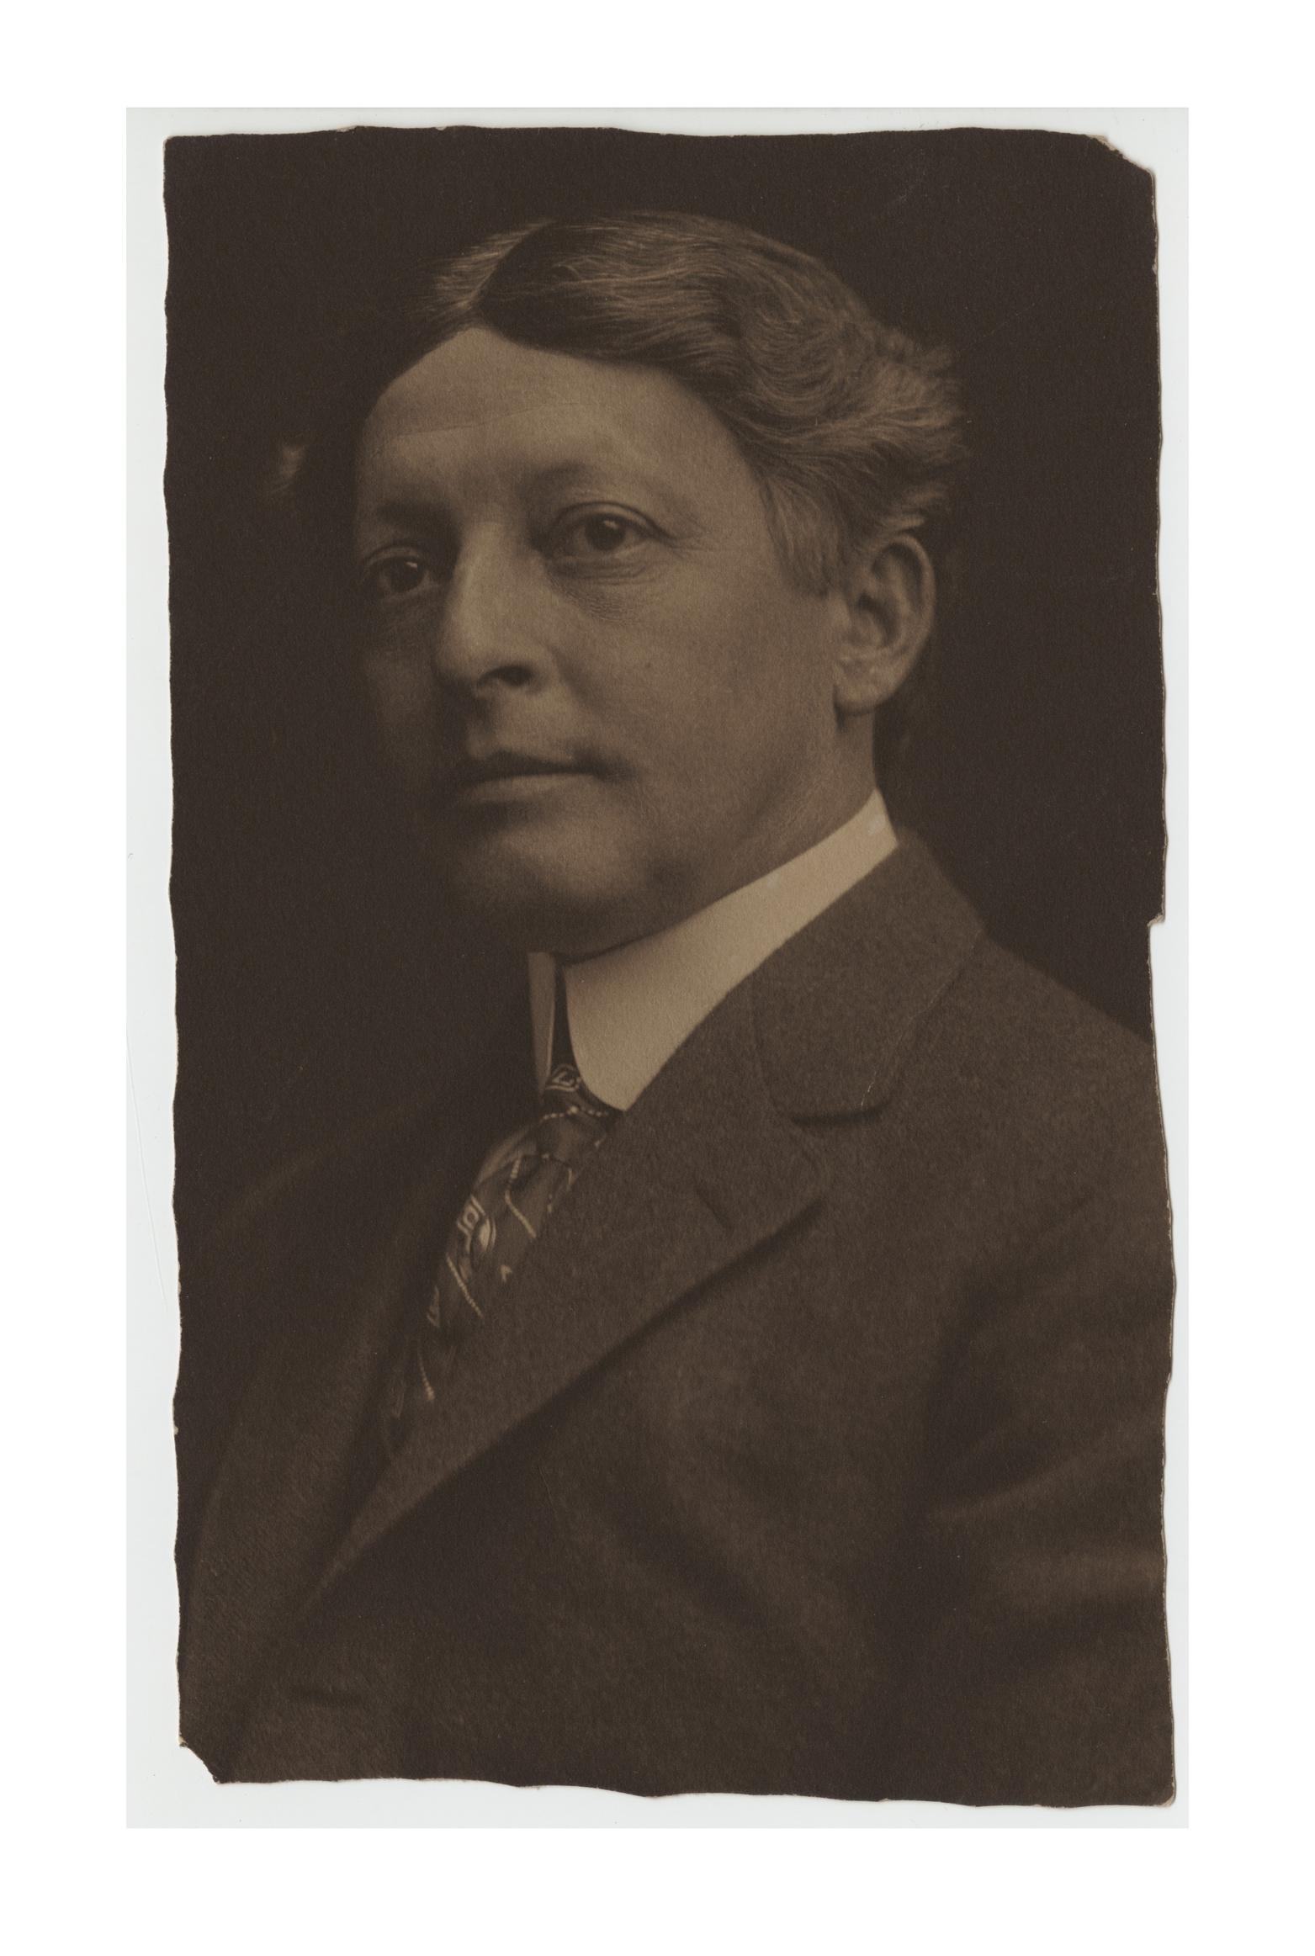
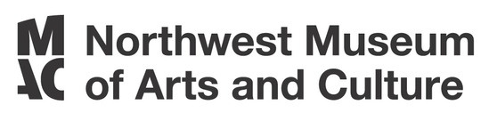
DIGITAL MAC PACK: SPOKANE ARCHITECT KIRTLAND CUTTER
PHOTO OF KIRTLAND CUTTER
JOEL E. FERRIS RESEARCH ARCHIVES L85-174.5
KIRTLAND CUTTER
KIRTLAND CUTTER WAS BORN IN CLEVELAND, OHIO AUGUST 20, 1860. WHILE HIS EDUCATION INCLUDED ATTENDING BROOKS MILITARY ACADEMY, HIS REAL PASSION WAS IN ART AND ARCHITECTURE. AFTER MILITARY SCHOOL, HE ATTENDED THE ARTS STUDENTS LEAGUE OF NEW YORK. HE THEN TRAVELED TO EUROPE WHERE HE SPENT SEVERAL YEARS STUDYING AND EXPLORING THE ART AND ARCHITECTURE EUROPE HAD TO OFFER.
  Budding Artist

Slide 2
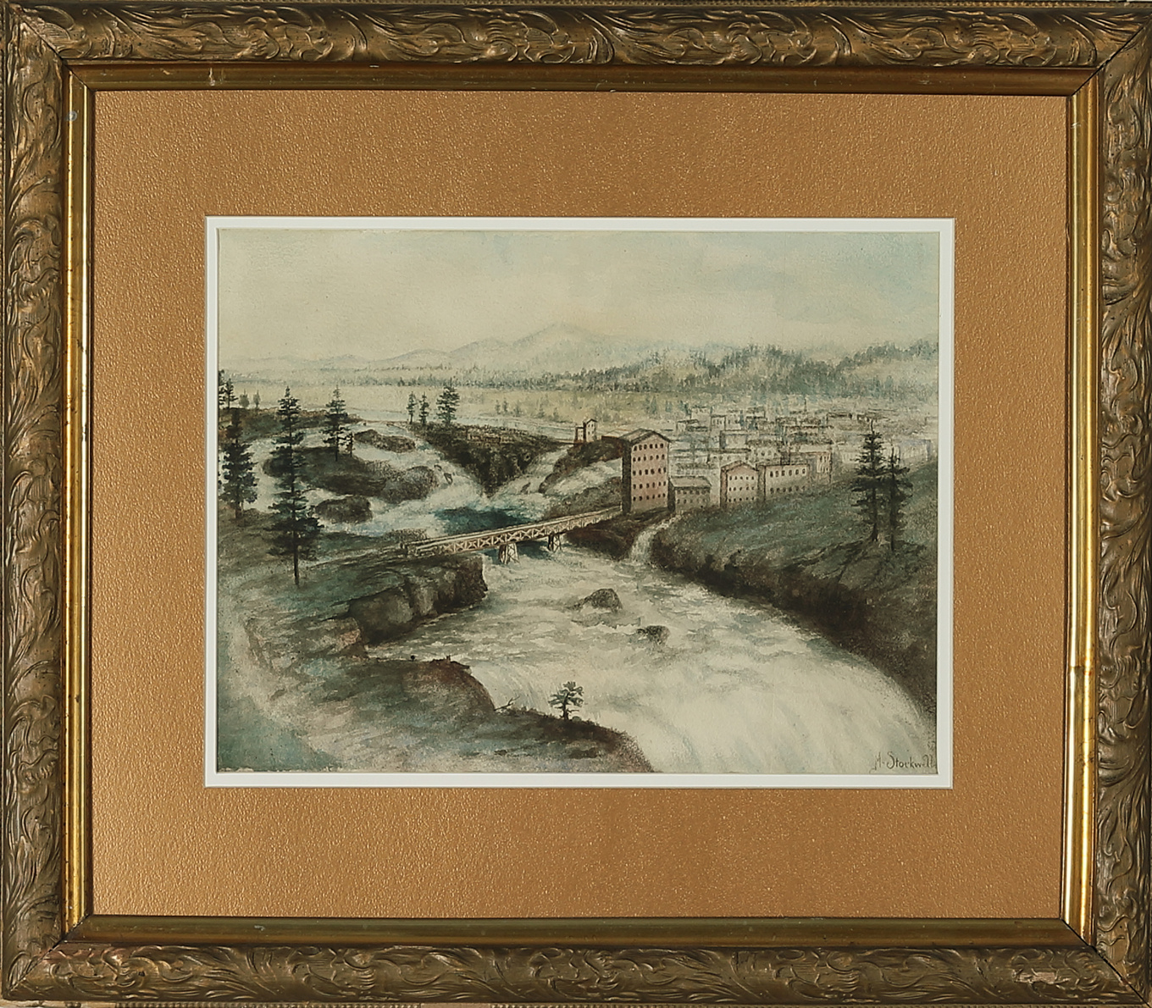
DIGITAL MAC PACK: SPOKANE ARCHITECT KIRTLAND CUTTER
VIEW OF SPOKANE FALLS FROM THE NORTH SIDE OF THE RIVER 1864-1914
MAC 3125.1
BOOMTOWN!
IN 1881, THE NORTHERN PACIFIC RAILROAD HAD LAID TRACKS FROM SEATTLE TO SPOKANE. BY 1883, YOU COULD RIDE THE TRAIN ALL THE WAY TO NEW YORK CITY. THE TRANSCONTINENTAL RAILROAD SYSTEM TURNED SPOKANE INTO A BOOMTOWN! PEOPLE FROM ALL OVER THE UNITED STATES AND THE WORLD POURED INTO THE CITY LOOKING FOR NEW OPPORTUNITIES. THIS PHENOMENON SHOWS UP IN THE POPULATION STATISTICS. IN 1880 SPOKANE HAD A POPULATION OF 350. BY 1910 THE POPULATION HAD GROWN TO 104,000. RETURNING FROM EUROPE, KIRTLAND CUTTER WAS ONE OF THOSE LOOKING FOR NEW OPPORTUNITIES IN SPOKANE.
  Spokane Falls

Slide 3
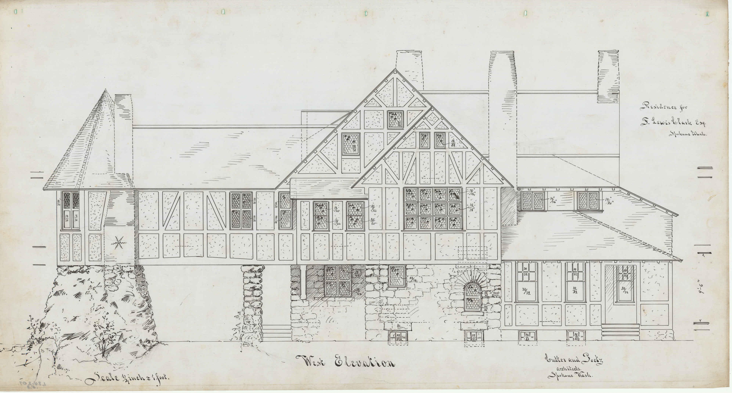
DIGITAL MAC PACK: SPOKANE ARCHITECT KIRTLAND CUTTER
CUTTER ARCHITECTURAL DRAWINGS OF LEWIS F. CLARK HOUSE 1890
JOEL E. FERRIS RESEARCH ARCHIVES L84-207.5
THE START OF A CAREER
WHEN CUTTER CAME TO SPOKANE IN 1886, HE WORKED IN HIS UNCLE’S BANK BUT HAD VISIONS OF USING WHAT HE LEARNED DURING ART SCHOOL AND ON HIS GRAND TOUR OF EUROPE TO WORK AS AN ARCHITECT. HIS FIRST KNOWN WORK WAS DESIGNING A HOME FOR HIS UNCLE, HORACE CUTTER, ON STEVENS STREET IN 1887. THE GREAT SPOKANE FIRE OF 1889 CREATED A DEMAND FOR NEW STRUCTURES. IT HELPED LAUNCH CUTTER’S CAREER AS AN ARCHITECT. EVENTUALLY, HE PARTNERED WITH KARL MALMGREN AND STARTED THE ARCHITECTURAL FIRM OF CUTTER AND MALMGREN. MANY HOMES AND BUSINESSES AROUND SPOKANE WERE DESIGNED BY THEIR FIRM. AS SPOKANE GREW, CUTTER AND MALMGREN’S BUSINESS AND REPUTATION GREW. THEY BEGAN DESIGNING PROPERTIES FOR WEALTHY FOLKS THROUGHOUT THE NORTHWEST INCLUDING SEATTLE AND MONTANA.
  Growing Reputation

Slide 4
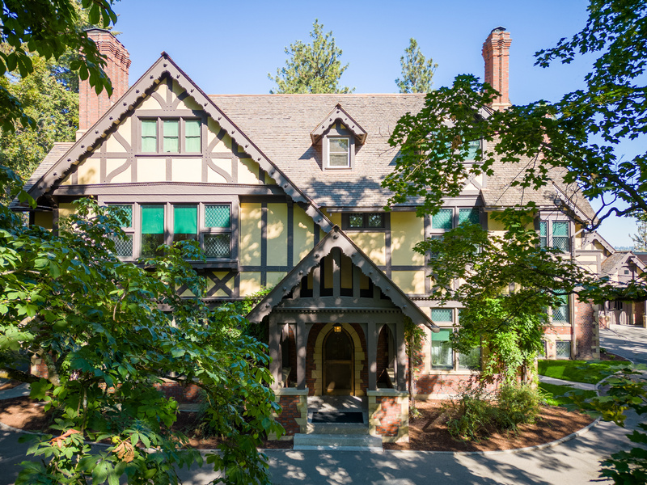
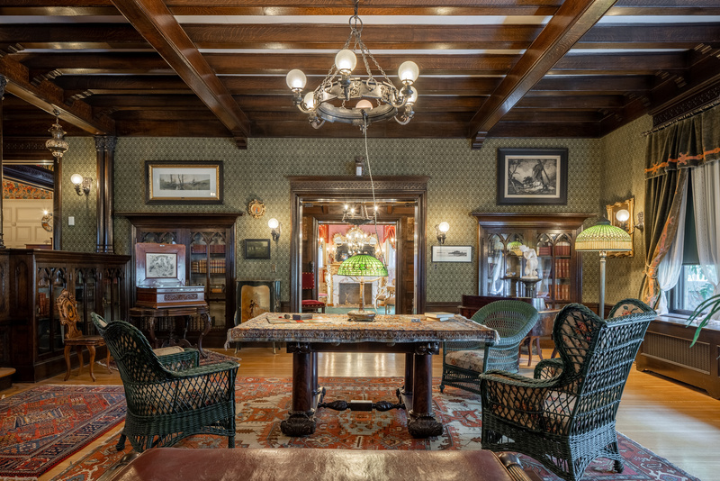
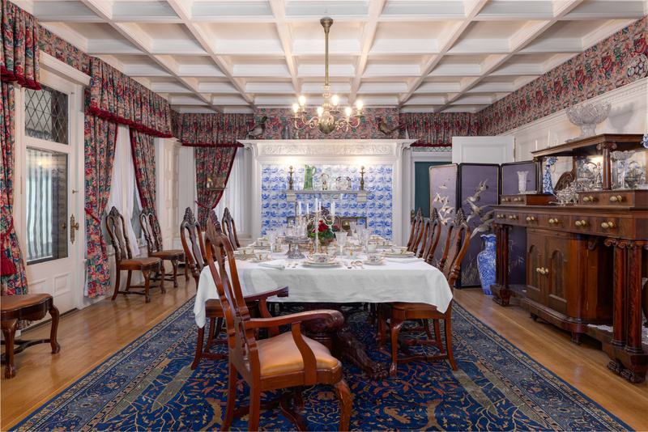
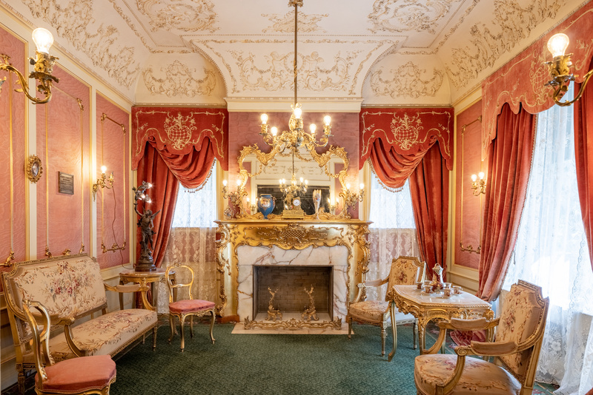
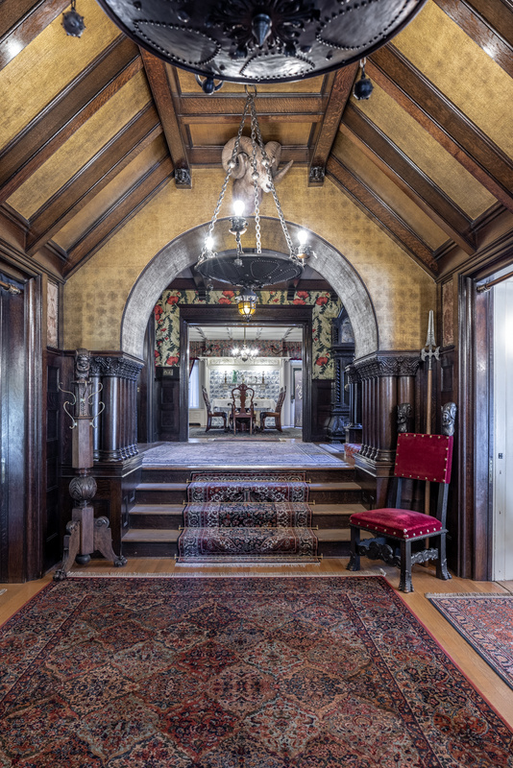
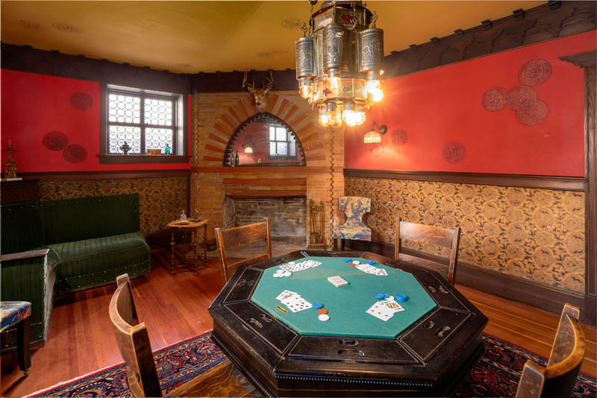
DIGITAL MAC PACK: SPOKANE ARCHITECT KIRTLAND CUTTER
FROM TOP LEFT: EXTERIOR OF CAMPBELL HOUSE, CAMPBELL HOUSE LIBRARY, DINING ROOM, RECEPTION ROOM, FRONT HALL, AND DEN
PHOTO CREDIT: DEAN DAVIS
ARTS AND CRAFTS REVIVAL
CUTTER SPECIALIZED IN AN ARCHITECTURAL STYLE KNOWN AS ARTS AND CRAFTS REVIVAL. IT WAS A NOSTALGIC LOOK BACK AT THE HOMES AND DECORATIVE ARTS FROM PRE-INDUSTRIAL TIMES. IT INCLUDED AN APPRECIATION OF ART FROM CULTURES THAT EUROPEANS AND AMERICANS SAW AS EXOTIC. CAMPBELL HOUSE IS AN EXAMPLE OF THIS POPULAR STYLE. THE HOME’S EXTERIOR IS TUDOR REVIVAL; THE ENTRY HALL AND LIBRARY REFLECT A GOTHIC, MEDIEVAL STYLE; THE RECEPTION ROOM IS FRENCH ROCOCO; AND THE FORMAL DINING ROOM IS COLONIAL. THE DEN WAS A STYLE REFERRED TO AS MOORISH AND INCLUDED DECORATIVE ARTS THAT LOOK ASIAN AND MIDDLE EASTERN. THE ARTS AND CRAFTS REVIVAL STYLES WAS VERY POPULAR THROUGHOUT EUROPE AND AMERICA.
  Arts & Crafts Revival styles

Slide 5
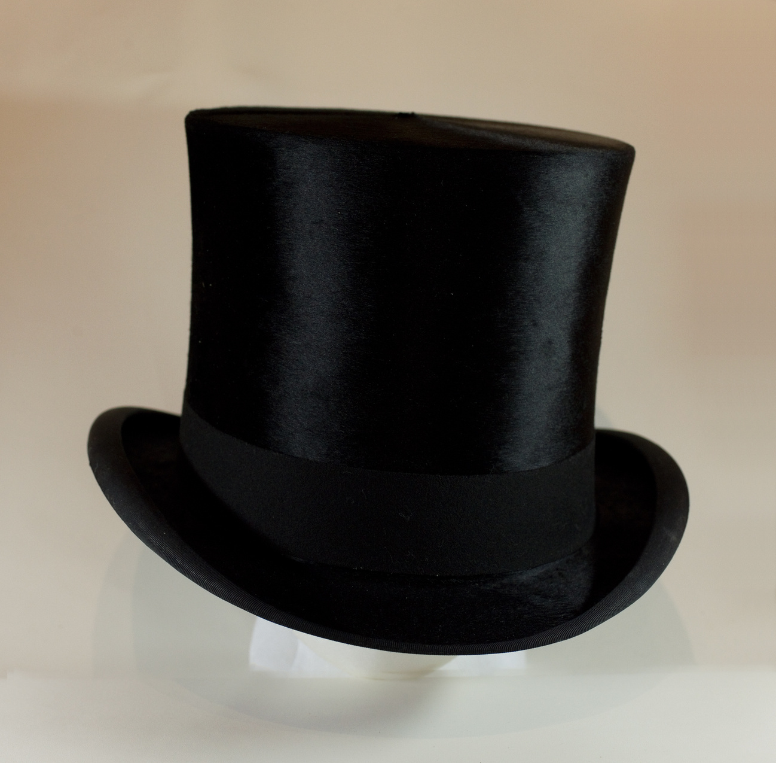
DIGITAL MAC PACK: SPOKANE ARCHITECT KIRTLAND CUTTER
KIRTLAND CUTTER’S TOP HAT
MAC 3189.2
ACCOMPLISHMENTS
NOT ONLY DID KIRTLAND CUTTER DESIGN CAMPBELL HOUSE, BUT HE ALSO DESIGNED MANY OTHER PRIVATE HOMES THROUGHOUT SPOKANE AND THE NORTHWEST, INCLUDING THE GLOVER MANSION, THE FINCH HOUSE, AND PATSY CLARK’S MANSION. HE DESIGNED MANY PUBLIC BUILDINGS AS WELL, SUCH AS THE DAVENPORT HOTEL. HIS RISING STAR IN SPOKANE GAVE HIM OPPORTUNITIES ELSEWHERE. HE DESIGNED THE IDAHO STATE BUILDING AT THE CHICAGO WORLD’S FAIR OF 1893, THE LAKE MCDONALD LODGE IN MONTANA’S GLACIER NATIONAL PARK, AND THE RAINIER CLUB IN SEATTLE. HE SAT ON THE EXECUTIVE COMMITTEE OF THE ARCHITECTURAL LEAGUE OF THE PACIFIC COAST AND WAS A VICE-PRESIDENT OF THE WASHINGTON STATE CHAPTER OF THE AMERICAN INSTITUTE OF ARCHITECTS.
  Cutter’s Accomplishments

Slide 6
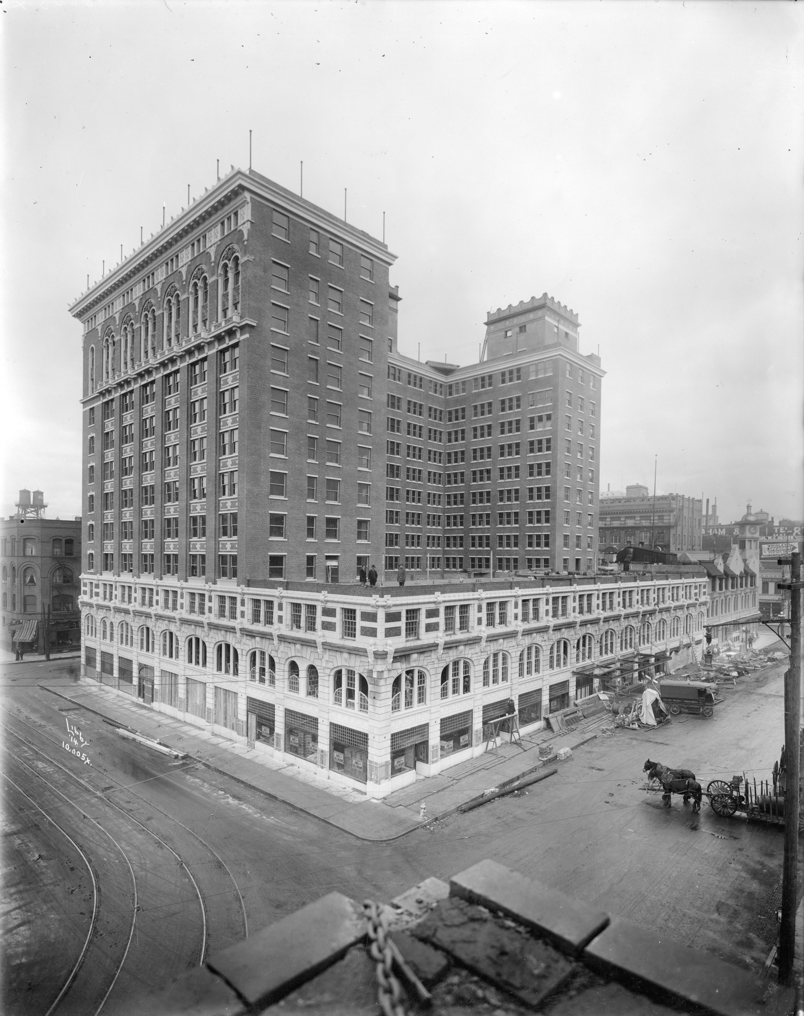
DIGITAL MAC PACK: SPOKANE ARCHITECT KIRTLAND CUTTER
1914 DAVENPORT HOTEL
JOEL E. FERRIS RESEARCH ARCHIVES L87-1.005X
A MOVE TO CALIFORNIA
RISKY INVESTMENTS AND CHANGING ARCHITECTURAL TASTES IN THE 1920'S COLLAPSED CUTTER’S SPOKANE FIRM. IN 1923 KIRTLAND CUTTER MOVED TO LONG BEACH, CALIFORNIA WHERE HE ONCE AGAIN DESIGNED HOMES AND COMMERCIAL PROPERTIES, SPECIALIZING IN WHAT WAS KNOWN AS “CALIFORNIAN STYLE” UNTIL HIS DEATH IN 1939.
SPOKANE REMAINS KIRTLAND CUTTER’S LEGACY. MANY OF THE STRUCTURES HE DESIGNED IN SPOKANE ARE STILL STANDING. THESE PROPERTIES ARE ICONIC TO THE ARCHITECTURAL LANDSCAPE AND LOOK OF SPOKANE AND ARE STILL ENJOYED, LIVED IN, AND VISITED BY SPOKANE RESIDENTS. HAVE YOU BEEN INSIDE A BUILDING OR HOME DESIGNED BY KIRTLAND CUTTER?
  Cutter’s Legacy

Slide 7
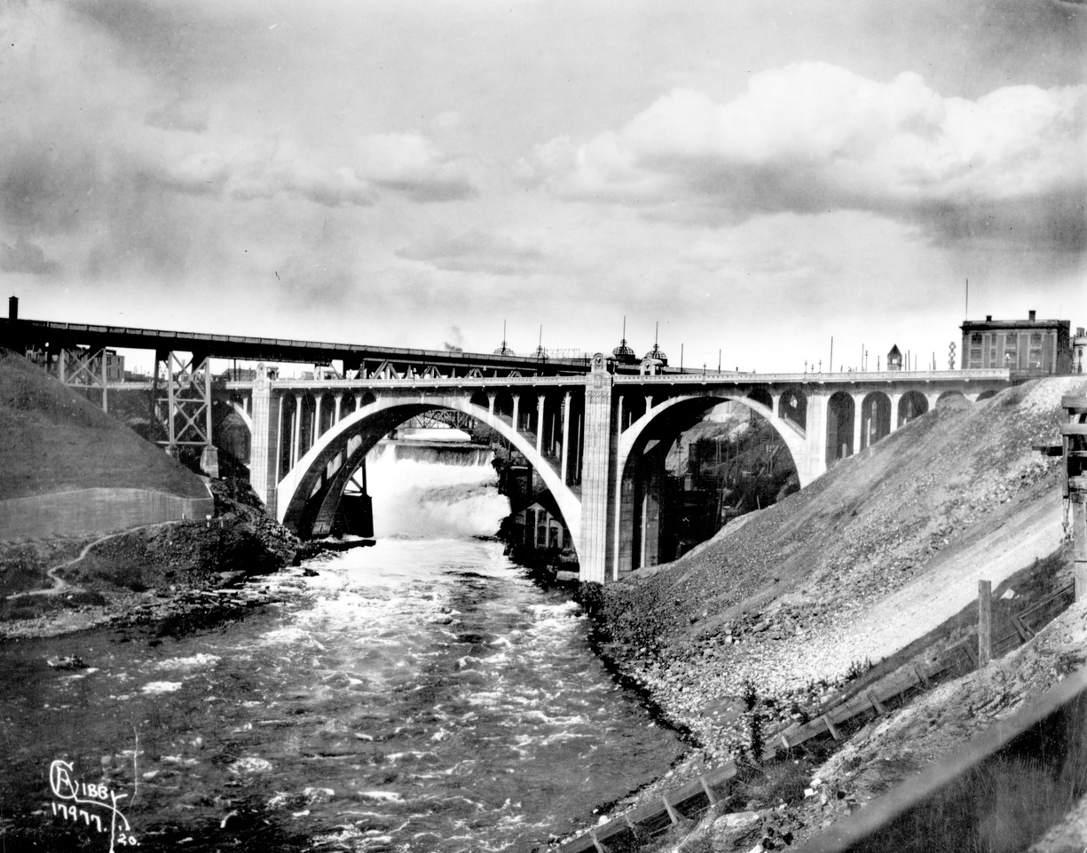
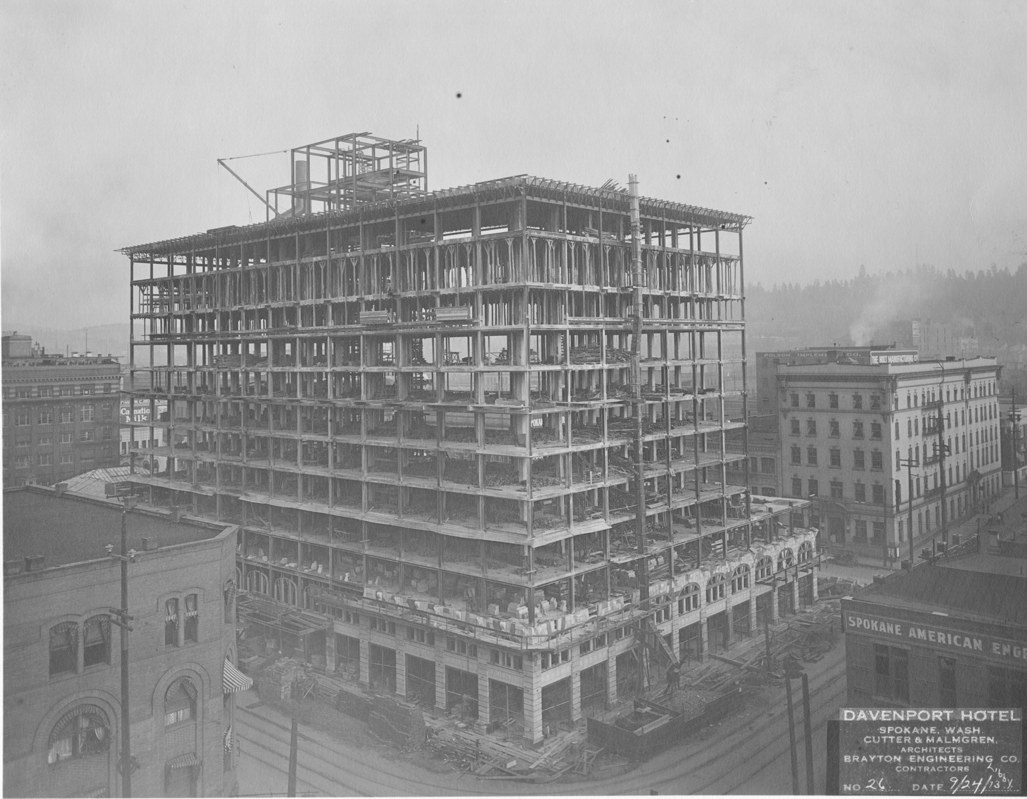
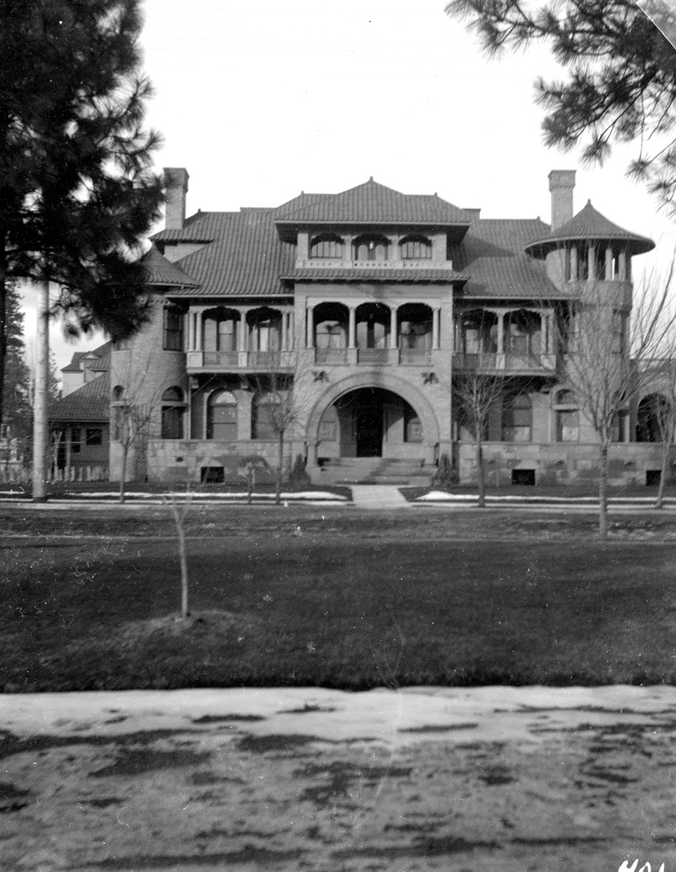
DIGITAL MAC PACK: SPOKANE ARCHITECT KIRTLAND CUTTER
MONROE STREET BRIDGE 1920 CUTTER AND MALGREN DESIGNED THE ORNAMENTATION ON THE BRIDGE
JOEL E. FERRIS ARCHIVES L87-1.7977
DAVENPORT HOTEL CONSTRUCTION 1913
JOEL E. FERRIS ARCHIVES L87-1.2.13
PATSY CLARK MANSION IN BROWNE’S ADDITION 1901
JOEL E. FERRIS ARCHIVES L99-22.401
WHERE TO LOOK FOR PRIMARY SOURCES
RESEARCH SPOKANE HISTORY
WANT TO LEARN MORE ABOUT SPOKANE HISTORY?
HERE ARE IDEAS TO FIND MORE INFORMATION:
  USE THE MAC’S WEBSITE TO RESEARCH ONLINE PHOTOS AND OBJECTS: HTTPS://WWW.NORTHWESTMUSEUM.ORG
  VISIT HISTORIC CAMPBELL HOUSE AT THE MAC
  CHECK OUT THE EXHIBITS AT THE MAC
  MAKE AN APPOINTMENT AT THE MAC TO SEARCH OUR ARCHIVES
  SEARCH THROUGH SPOKESMAN REVIEW AND SPOKANE CHRONICLE HISTORIC NEWSPAPERS
  VISIT WASHINGTON STATE ARCHIVES: HTTPS://WWW.SOS.WA.GOV/ARCHIVES/ARCHIVES_EASTERN.ASPX
  VISIT THE NORTHWEST ROOM AT THE SPOKANE PUBLIC LIBRARY: HTTPS://SPOKANELIBRARY.ORG/NORTHWEST-ROOM
  CONTACT WASHINGTON STATE UNIVERSITY ARCHIVES: HTTPS://LIBRARIES.WSU.EDU/MASC/UNIVERSITY-ARCHIVES/

Slide 8
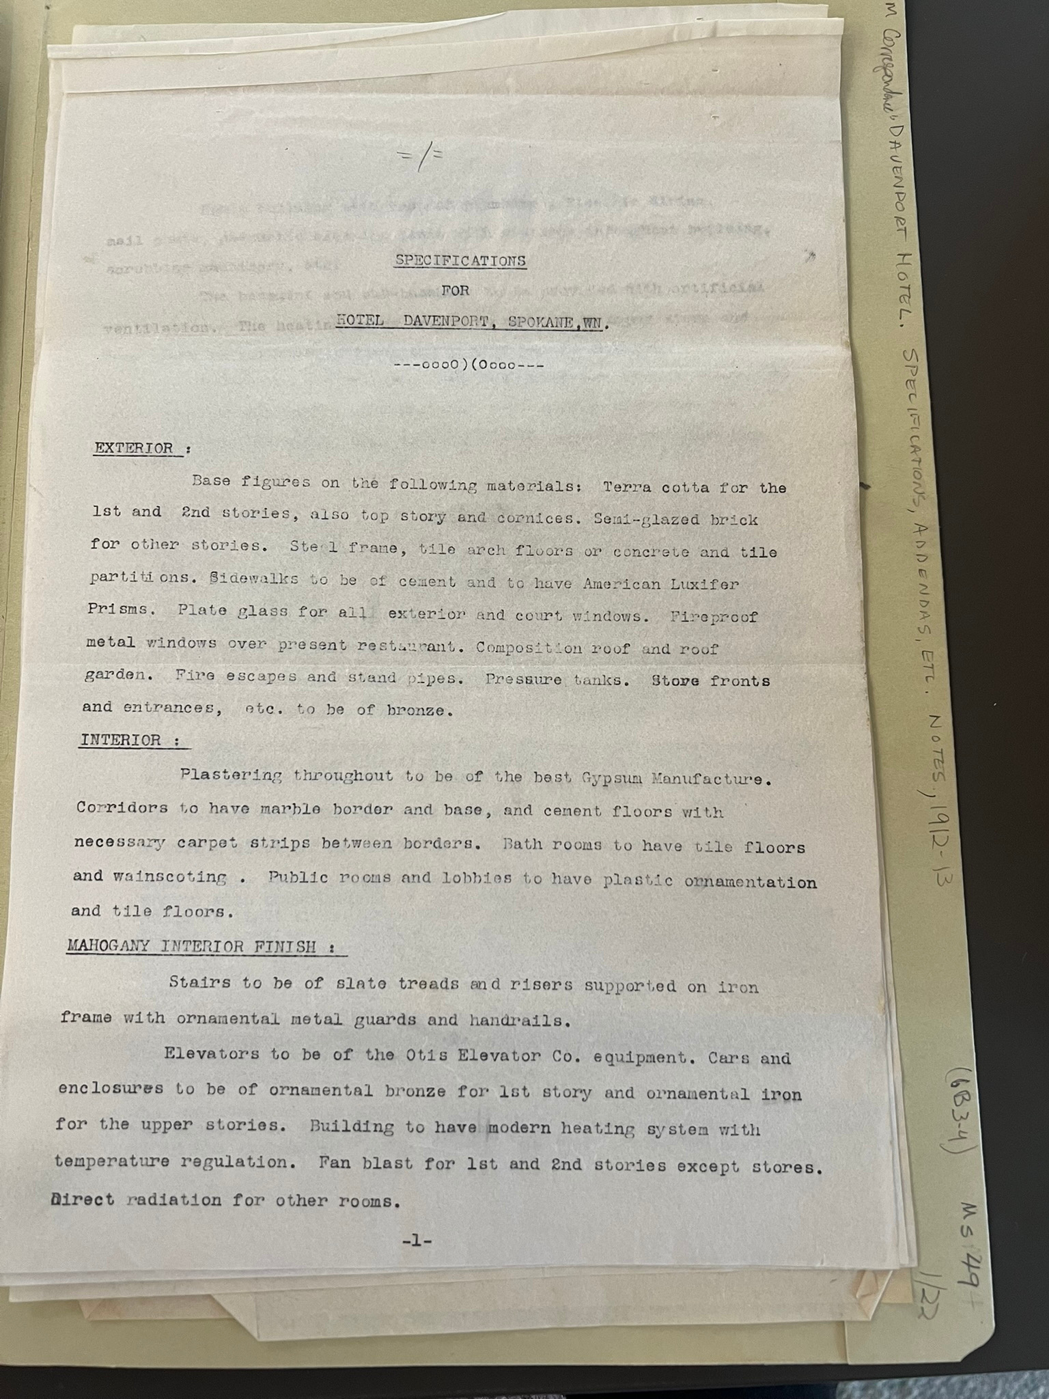
DIGITAL MAC PACK: ANALYZING NEWSPAPERS AND DOCUMENTS
DAVENPORT HOTEL CONSTRUCTION PLAN 1912-1913
JOEL E. FERRIS ARCHIVES MS49 6B 3-4

Slide 9
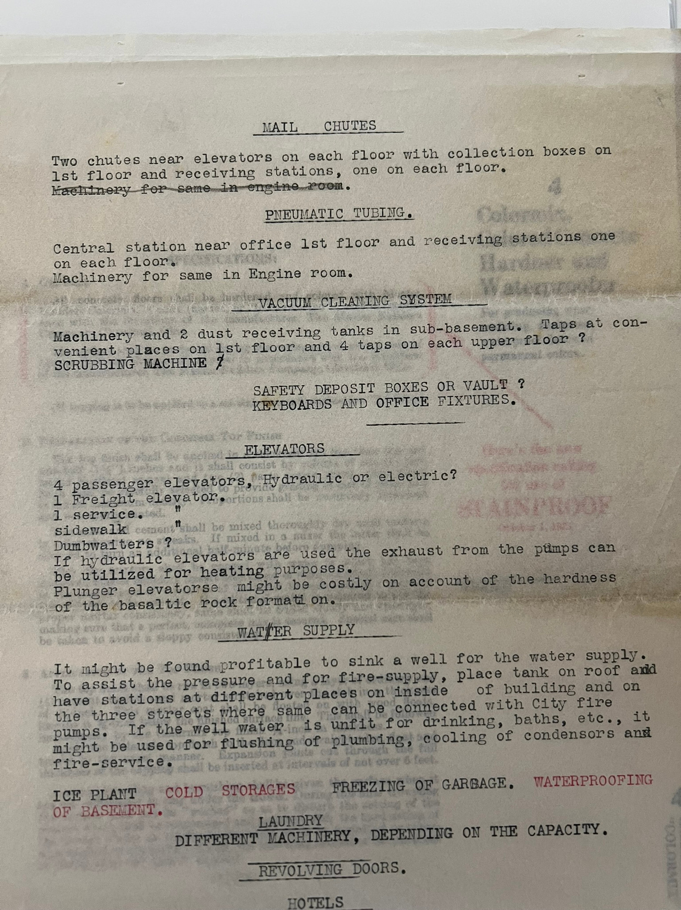
DIGITAL MAC PACK: ANALYZING NEWSPAPERS AND DOCUMENTS
DAVENPORT HOTEL CONSTRUCTION PLAN 1912-1913
JOEL E. FERRIS ARCHIVES MS49

Slide 10
DIGITAL MAC PACK: ANALYZING NEWSPAPERS AND DOCUMENTS
Every piece of paper that people leave behind is full of clues. From diaries and letters to newspapers and census reports, documents tell us about the circumstances of everyday life and about significant events.
Tips for reading and analyzing documents and newspapers:
To be most useful, documents must be studied carefully and critically. (From Smithsonian resources: Engaging Students with Primary Sources)
What are your first impressions? What kind of document is it (letter, newspaper, etc.)? How do you know?
Look more closely: Read through the document carefully. Make a list of any unusual words or phrases.
Is there a date on it? If so, what is it? If not, are there any other clues that might indicate when it was written?
Is there a location indicated? What is it?
Who wrote or created the document? How can you tell?
For whom was the document written or created? How do you know?
What is the purpose of the document? What made you think this?
Thinking Further: What do you think the writer thought was the most important information to convey? Why?
Does the document convey a certain tone?
What does it imply without stating directly?
Can you tell the point of view of the writer? Is it objective?
What is the relationship between the writer and the audience? How can you tell?

Slide 11
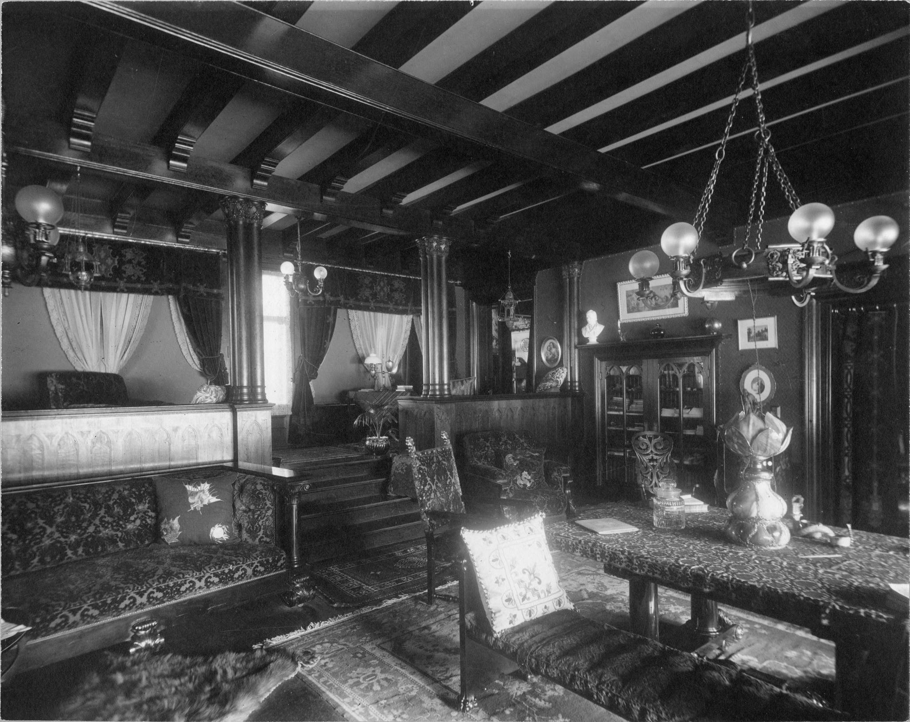
DIGITAL MAC PACK: ANALYZING PHOTOGRAPHS
TAKE A FEW MINUTES TO LOOK CLOSELY AT THIS PHOTOGRAPH.
WHAT’S GOING ON WITH THIS PHOTOGRAPH?
WHAT DO YOU SEE THAT MAKES YOU THINK THAT?
WHAT MORE CAN YOU FIND?
SEE THE QUESTIONS ON THE NEXT PAGE TO HELP YOU ANALYZE THIS PHOTO AND THE OTHER PHOTOS IN THIS DIGITAL MAC PACK.
CAMPBELL HOUSE LIBRARY 1910
JOEL E. FERRIS RESEARCH ARCHIVES L91-120.28
  What’s going on in this photo?

Slide 12
DIGITAL MAC PACK: ANALYZING PHOTOS
Photographs provide us with images of past events. Today, historians study the content and the meaning of these visual images to locate information about a particular topic, time, or event. Photographs can convey countless details about life. For historians and for us, “A picture is worth a thousand words.” Photographers can manipulate, intentionally or unintentionally, the record of the event. It is the photographer—and the camera’s frame—that defines the picture’s content. Thus, the photographer chooses what will be in the picture, what will be left out, and what the emphasis will be.
(From Smithsonian resources: Engaging Students with Primary Sources)
Take a few minutes to look at the photos in this Digital MAC Pack. Use these questions to help you analyze what’s going on in this photo:
First Impressions: What are your first impressions?
Take a closer look: Make sure to examine the whole photograph. Make a list of any people in the photograph. What is happening in the photograph? Make a list of any activities you see going on in the photograph. Make a list of any objects in the photograph.
Looking more closely: Are there any captions? A date? Location? Names of people? What kind of clothing is worn? Is there any lettering on signs or buildings? What time of year is pictured? Time of day? Cite your evidence. Where was the photograph taken? Cite your evidence.
Thinking Further: If people are in the photograph, what do you think is their relationship to one another? Can you speculate on a relationship of the people pictured and someone who is not in the picture?
Here are a few more tips for reading photographs: What do you think happened before and after the photo was taken? Who do you think took the photo and why?
What does this photograph suggest to you? What questions do you have about the photo? How could you try to answer them?
What is the one thing that you would remember most about this photograph and why?
What questions do you have about the photograph that you cannot answer through analyzing it? Where could you go next to answer these questions?

Slide 13
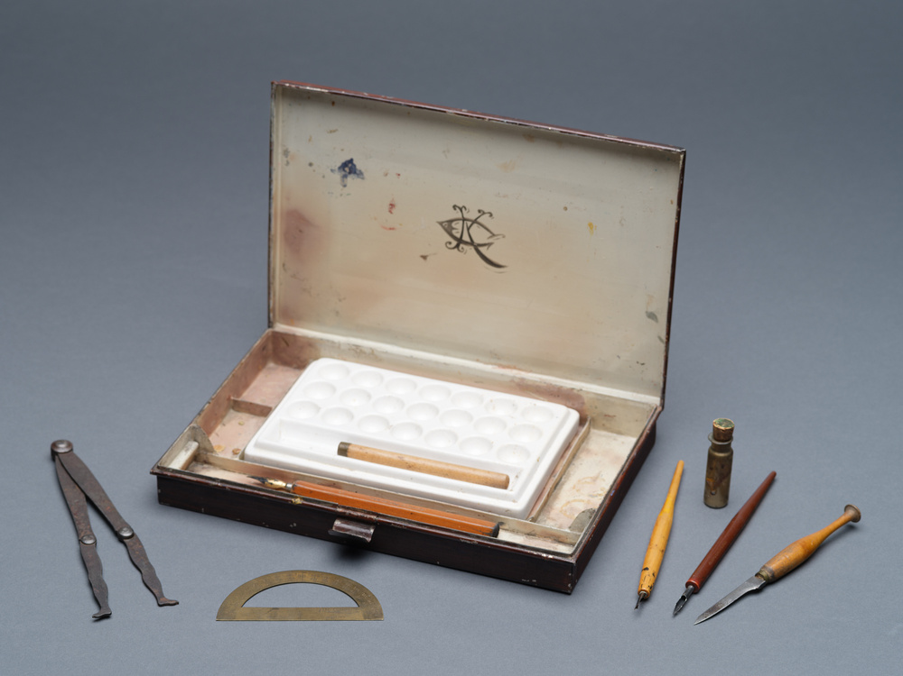
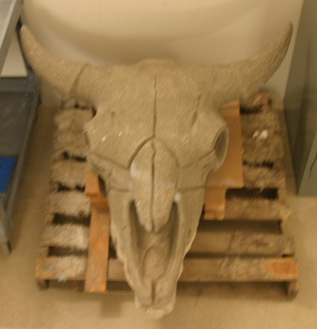
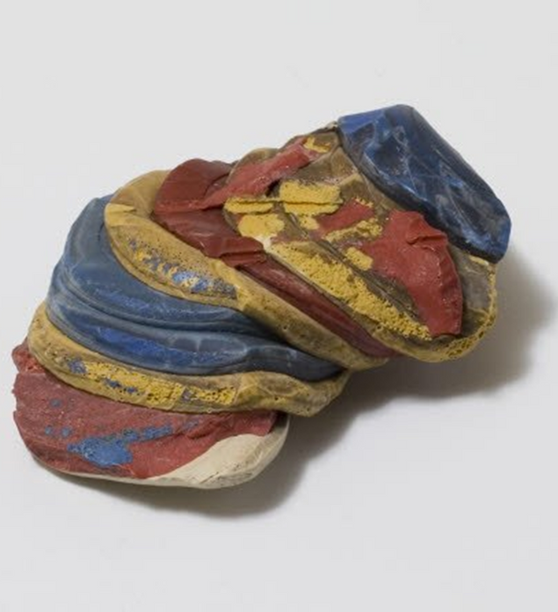
DIGITAL MAC PACK: ANALYZING OBJECTS
All Objects are from the Northwest Museum of Arts and Culture’s (MAC) Collections
MONROE STREET BRIDGE BISON SKULL ORNAMENT DESIGNED BY KIRTLAND CUTTER
MAC 4156.1
KIRTLAND CUTTER RENDERING KIT
MAC 3001.11
POKER CHIPS FROM THE SPOKANE FIRE OF 1889
MAC 1007.9A
KIRTLAND CUTTER TOP HAT
MAC 3189.2

Slide 14
DIGITAL MAC PACK: ANALYZING OBJECTS
Historians study objects, the material culture that people from the past left behind, in order to understand history. Because objects are the products of human workmanship - of human thought and effort - objects tell something about the people who designed, made, and used them. (From Smithsonian resources: Engaging Students with Primary Sources)
First Impressions: What are your first impressions of this object? Do you have any ideas what the object might have been used for?
Look more closely: Physical Features: What is it made of? Why was this material chosen? What is the texture and color? What does it smell like? Can it be held? Is it heavy or light? Is it intact, or does it look like parts are missing? Is it clean or dirty? Does it make a noise? Does it look old or new?
Construction: Is it handmade or made by machine? Where was it made?
Who made it?
Function: How is this object used? Does it have a practical use or is (was) it used for pleasure? Has it been used? Is it still in use? Has the use changed? Where can it be found? Where could it have been found? What value does it hold to you and to others?
Design: Is it designed well? Is it decorated? How is it decorated? Is it aesthetically pleasing? Would it make a good gift? Does it remind you of anything else?
Who may be connected with the object? What type of person might have used this object? What type of person might have made this object? What does this object tell us about the maker and user?
Thinking Further: Is this type of object still being made today? Is it still in use? If not, why do you think it isn’t used today?
Should this object be in a museum collection? Why or why not?
What questions do you have about the object that you can’t answer from just looking at it?

